Slide 1
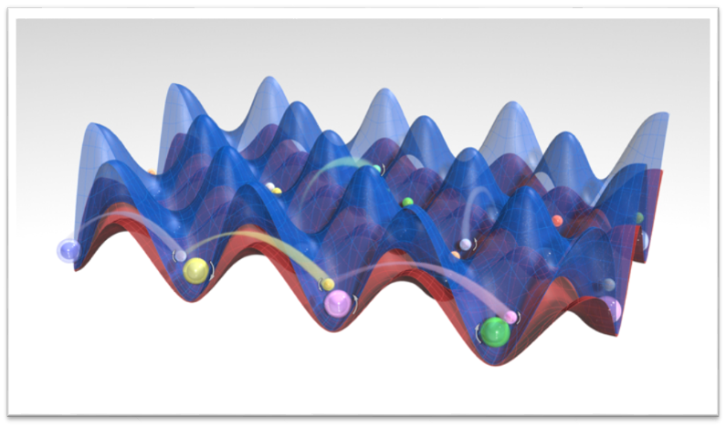
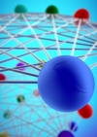

New perspectives on quantum simulation with Alkaline-earth atoms
Ana Maria Rey
Quantum Simulations with Ultracold gases Les Houches School of Physics, September 13-24 (2021)

Slide 2
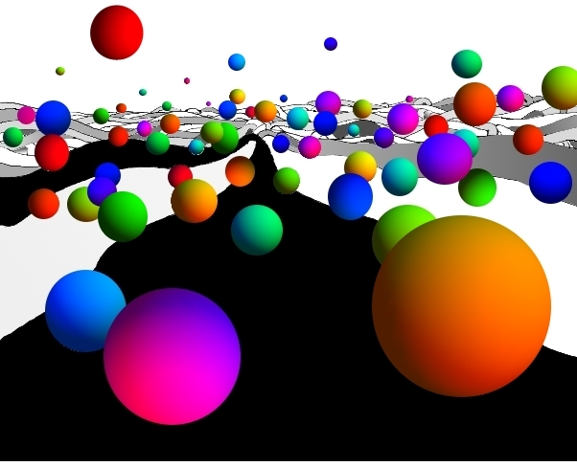
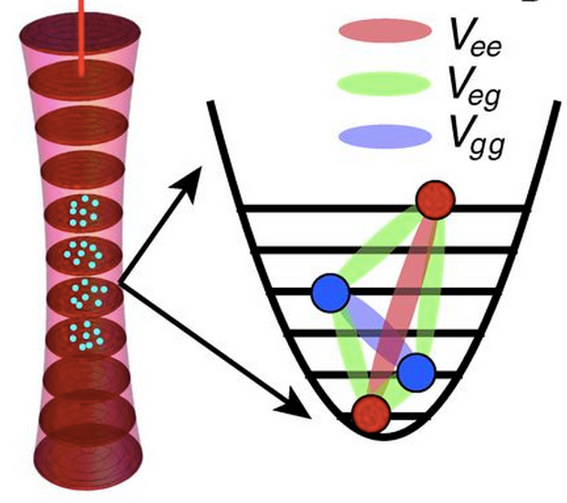

Agenda
pulse
Dark Time
pulse
Brief overview of alkaline earth-atoms and atomic clocks
Collisions and SU(N) Interactions
Density shifts in spin polarized gases
Probing SU(N) orbital magnetism
Spin-Orbit Coupling

Slide 3

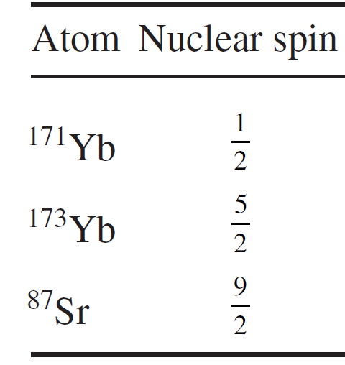
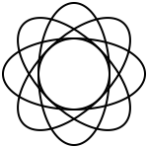
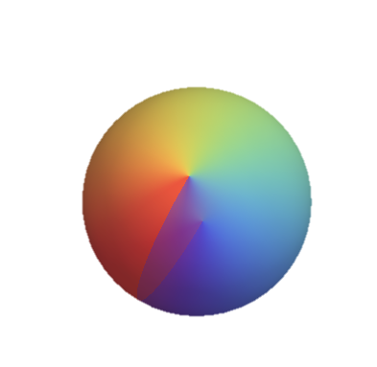
Alkaline Earth (-like) Atoms: AEA
A TALE OF TWIN ELECTRONS
Nucleus
I
Electrons
Fermionic isotopes have nuclear spin I > 0.
Why?: Bosonic isotopes have nuclei with even number of protons and neutrons: I=0
Fermionic Isotopes have even number of protons and odd number of neutrons
Notes:
Since the core of this talk is on alkaline earth atoms. Let me remind you what AEA are. AEA are those atoms with two outer electrons. Consequently they include those in the second column of the periodic table as well as those one with similar electronic structure such as Yb.
Cooled down Sr, Yb but also Calcium. Efforts on laser cooling Mg, Hg
Talk about neutrons, compare with alkali atoms

Slide 4
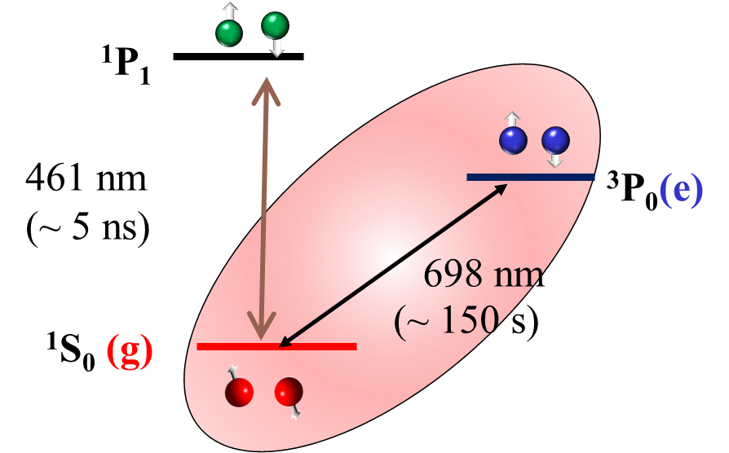
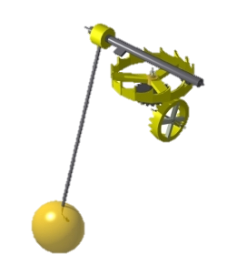
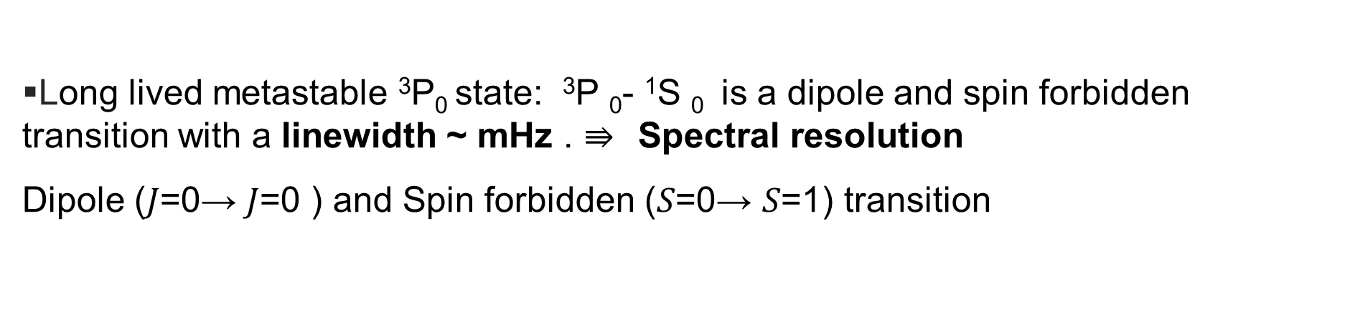
Alkaline earth(-like) atoms
Long lived metastable ³P₀ state: ³P ₀- ¹S ₀ is a dipole and spin forbidden transition with a linewidth ~ mHz . $⇛$Spectral resolution
Dipole (𝐽=0→ 𝐽=0 ) and Spin forbidden (𝑆=0→ 𝑆=1) transition
Unique atomic structure
Strontium: ⁸⁷ Sr
Metastable states
³P₀ (e)
Linewidth Δν₀~ mHz
ν₀=5x10¹⁴ Hz
lifetime ~ 10² sec
¹S₀ (g)
Quality factor: Q=ν₀/Δν₀ >10¹⁷
Once set, it swings during the entire age of the universe

Slide 5
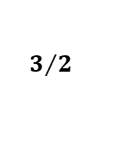
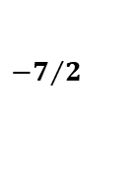
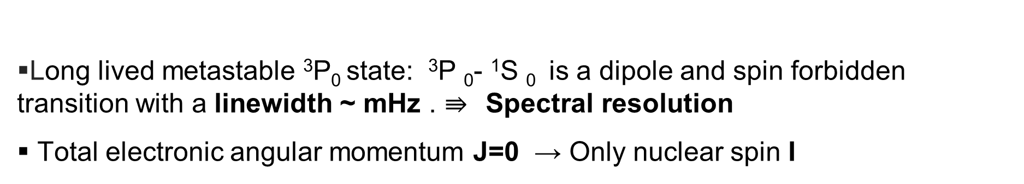
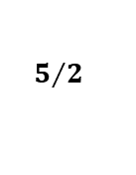
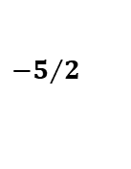
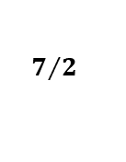
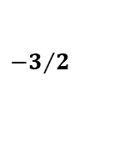
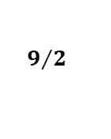
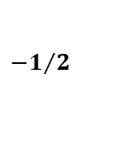
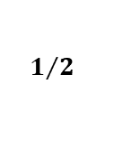
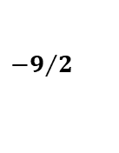
Alkaline earth(-like) atoms
Unique atomic structure
Long lived metastable ³P₀ state: ³P ₀- ¹S ₀ is a dipole and spin forbidden transition with a linewidth ~ mHz . $⇛$Spectral resolution
Total electronic angular momentum J=0 → Only nuclear spin I
Strontium: ⁸⁷ Sr
excited (e)
ground (g)
$${−1}/2$$
$${−3}/2$$
$${−5}/2$$
$${−7}/2$$
$${−9}/2$$
$$7/2$$
$$5/2$$
$$3/2$$
$$1/2$$
$$9/2$$
I=9/2 10 different states

Slide 6
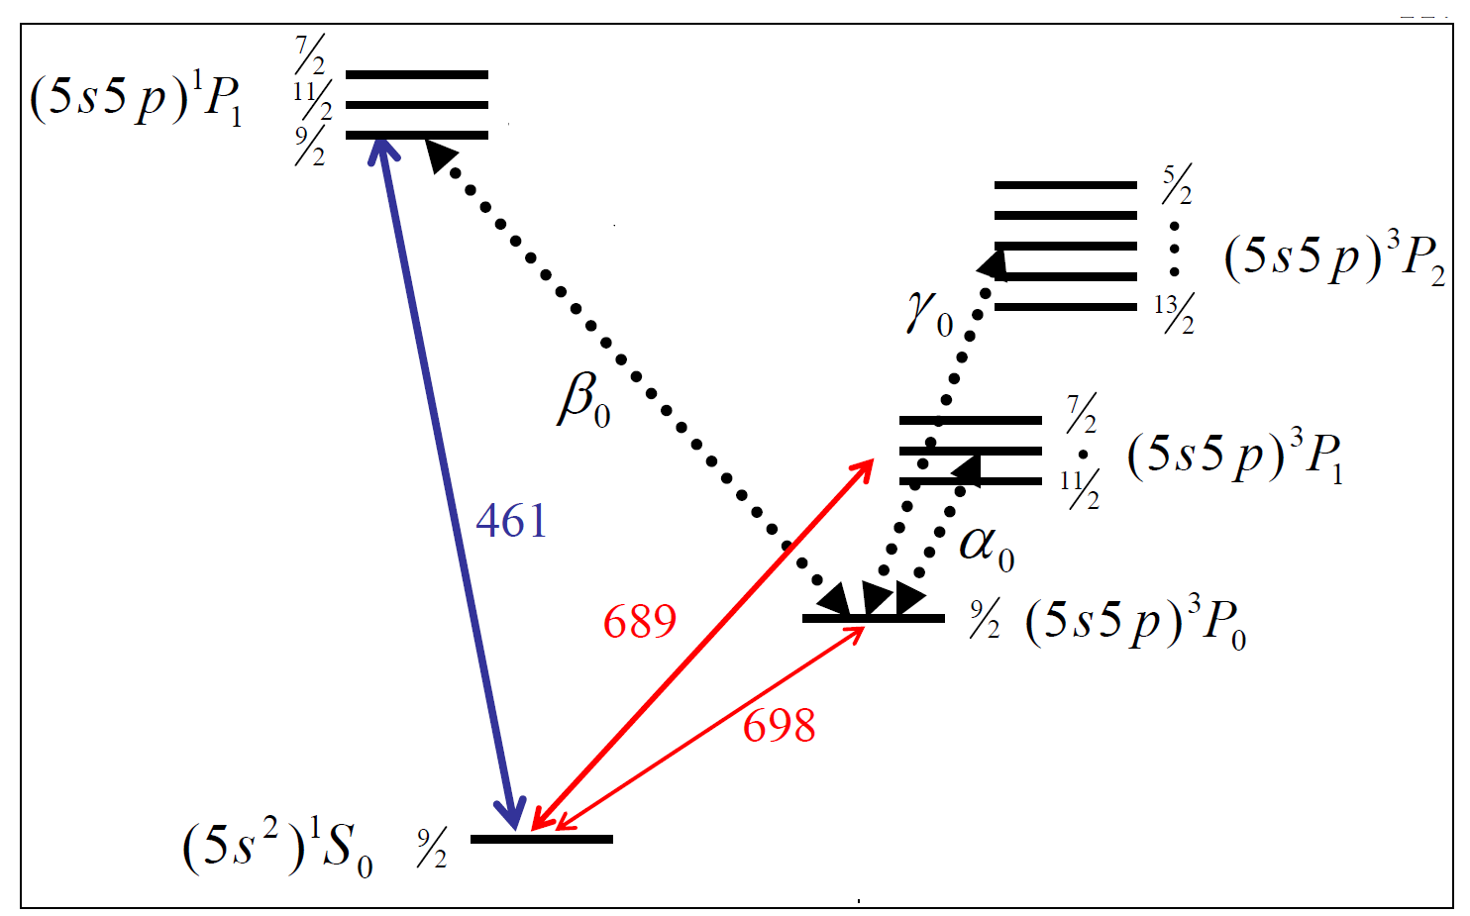
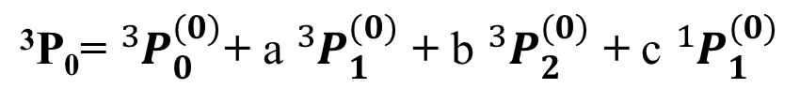
Why alkaline-earth (like) atoms?
Strontium: ⁸⁷ Sr
³P₀= ${}_{ }^{3}{P_{0}^{(0)}}$+ a ${}_{ }^{3}{P_{1}^{(0)}}$ + b ${}_{ }^{3}{P_{2}^{(0)}}$ + c ${}_{ }^{1}{P_{1}^{(0)}}$
Because Hyperfine Interactions $H=AI∙J$
Why?
How about Strontium: ⁸⁸ Sr?

Slide 7
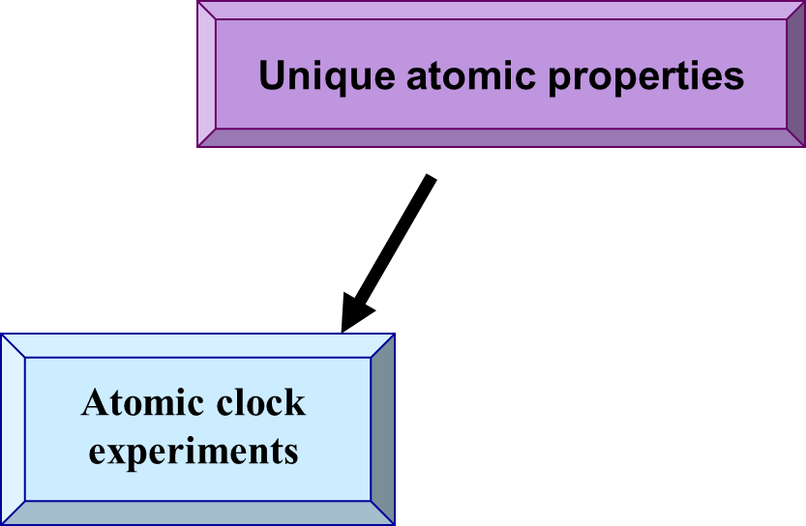
Why alkaline-earth (like) atoms?

Slide 8
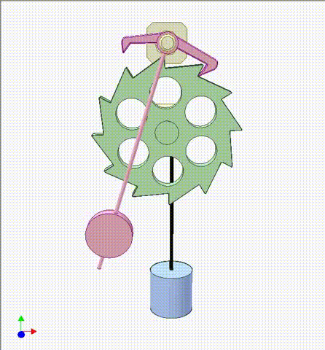
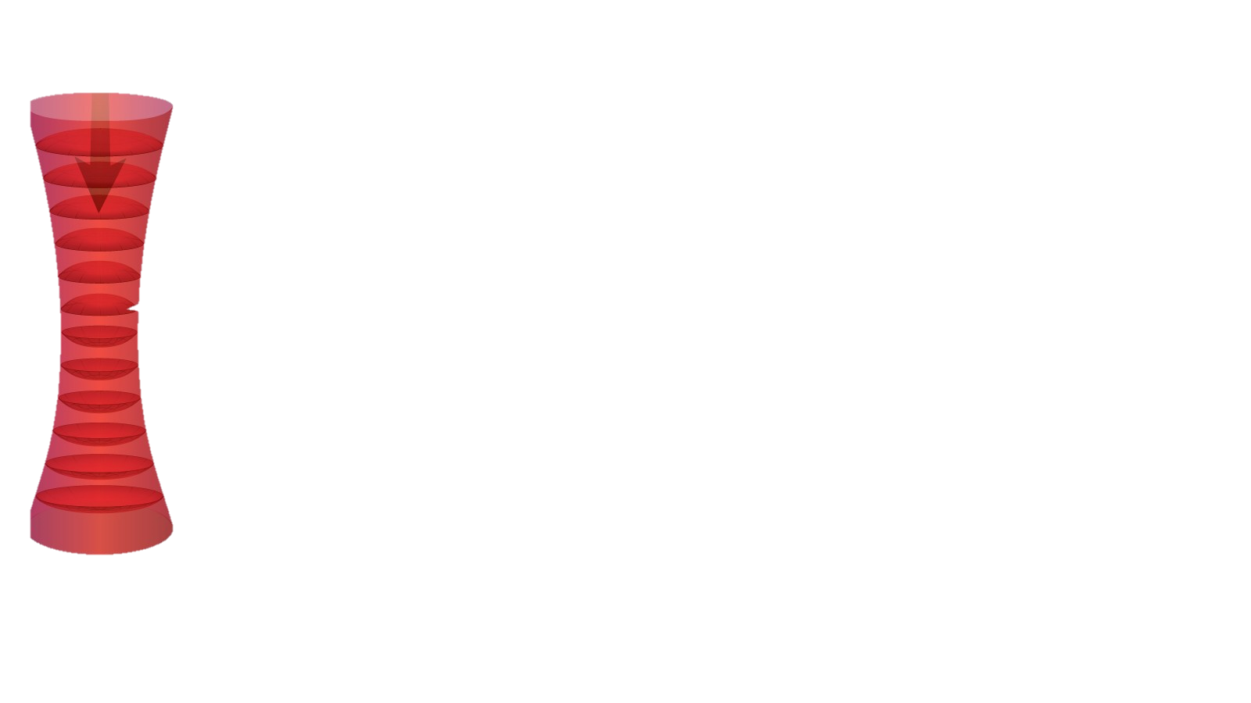
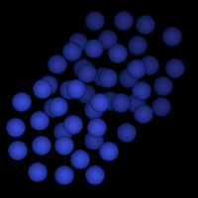
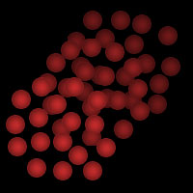

All Clocks
Atomic Clocks
Counter
_{Optical}
_{Light Source}
_{Atoms}
Oscillator
Counter
Oscillator
Notes:
So, how does an atomic clock work?
An atomic clock works like any other clock, except in this clock, light is the pendulum that ticks.
And, the atoms in the clock act like the counter. The atoms help us to keep track of the oscillations. How they do that?
Well thanks to their quantum nature.

Slide 9
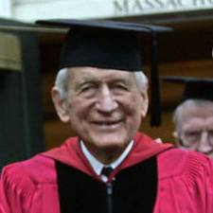
Ramsey Spectroscopy
e
ω_{L}
ω₀
g
N. Ramsey. Nobel prize 1989
δ= (ω_{L}− ω₀ )
Detuning

Slide 10
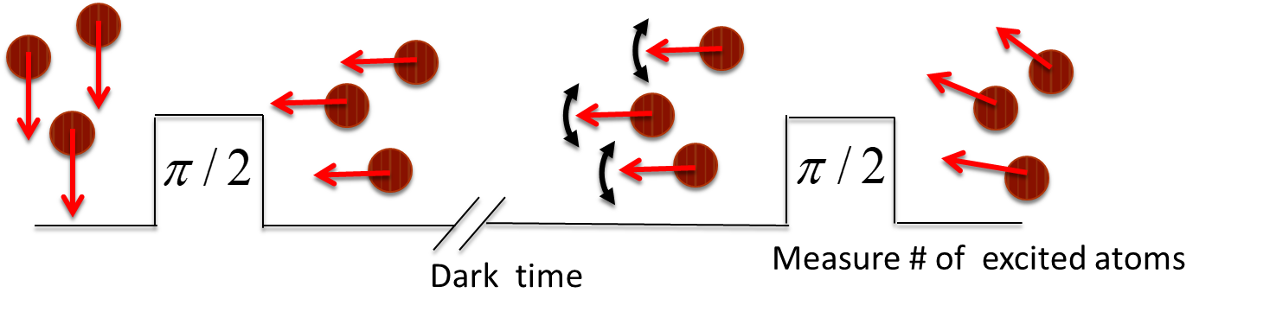




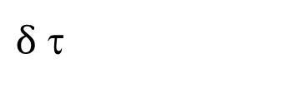

Ramsey Spectroscopy
$$−ℏδ{\hat{S}}_{z}$$
$$ℏΩ{\hat{S}}_{x}$$
$$θ$$
N. Ramsey. Nobel prize 1989
$$θ=Ωt$$
Pulse area
$\left\langle \hat{S}\right\rangle =\frac{1}{2}\{0,$ $\sin{θ,}−\cos{θ\} }$
$$\left\langle {\hat{S }}^{−}(τ)\right\rangle =−\frac{i}{2}\sin{θe^{−iδτ}}$$
$$\left\langle {\hat{S }}^{z}(τ)\right\rangle =\frac{1}{2}\sin{θ\cos{(δτ)}}$$
Phase
e
z
z
e
ω_{L}
ω₀
g
e-atoms
Contrast
δ= (ω_{L}− ω₀ )
Detuning
y
y
x
x
g
$δ$ τ

Slide 11
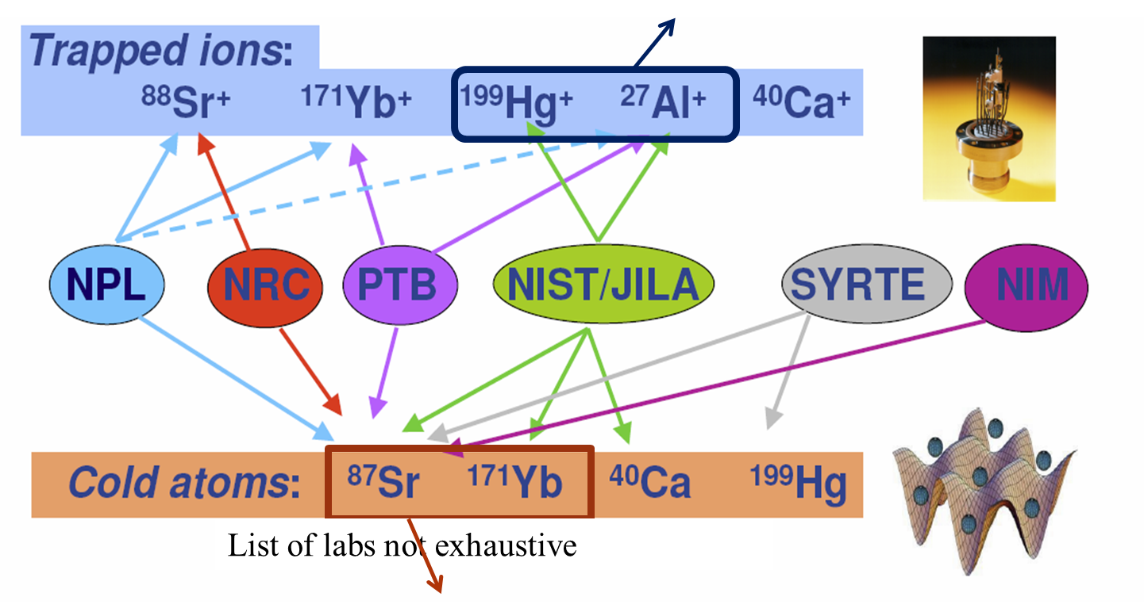
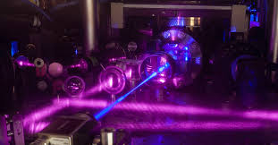
Optical clocks
Accuracy approaching 10⁻¹⁸
Low stability: only single ion
Neither gain nor lose one second in some 15 billion years—roughly the age of the universe.
Accuracy at 10⁻¹⁸
High stability: 10³⁻⁴ Many atoms
About 1000 times better than current cesium standard

Slide 12
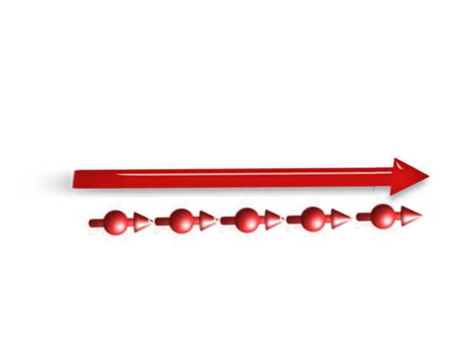
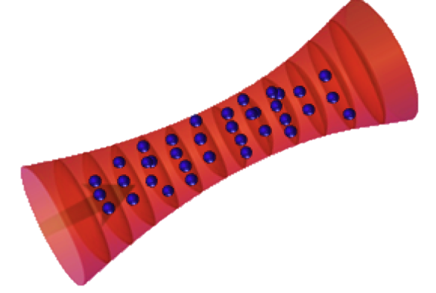


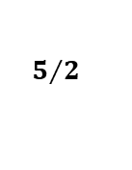
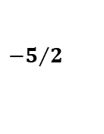
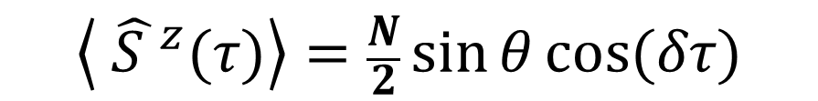
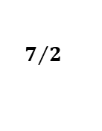
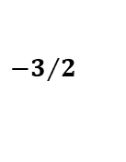
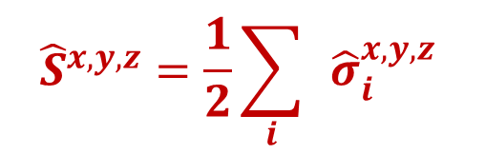
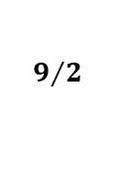
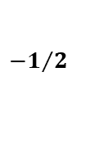
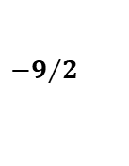
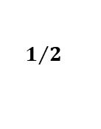
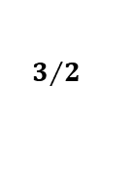
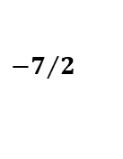
1D lattice clock: T~μK
What happens in the real experiment with many atoms?
No interaction: All the spins precess collectively
Large collective spin: Better signal to noise
$${\hat{S}}_{ }^{x,y,z}=\frac{1}{2}\sum_{i}{ }{{\hat{σ}}_{i}^{x,y,z}}_{ }$$
S
$$\left\langle {\hat{S }}^{z}(τ)\right\rangle =\frac{N}{2}\sin{θ\cos{(δτ)}}$$
Requirement:
All experience same Rabi frequency
(Resource for spin-orbit coupling)
All have same detunings: No Doppler& Stark Shifts: Deep Magic Lattice
Atomic Collisions?
$$1/2$$
$${−1}/2$$
$${−3}/2$$
$${−5}/2$$
$${−7}/2$$
$${−9}/2$$
$$7/2$$
$$5/2$$
$$3/2$$
$$9/2$$
Clock

Slide 13

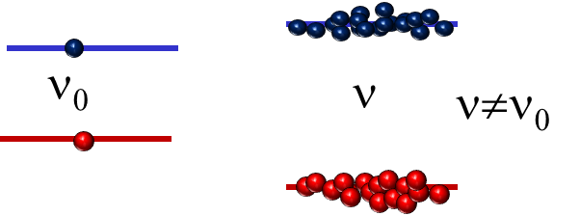
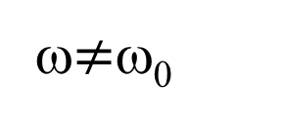
DILEMMA
More atoms better signal to noise
Atomic collisions change the frequency. Packing more atoms makes the error worse
Interactions:
Degraded signal: Even in identical fermionic atoms. In 2008 gave rise to the second largest uncertainty to the 10 ⁻¹⁶ error budget
JILA:G. Campbell et al Science 324, 360 (09)
ω₀
ω$≠$ω₀
Need to understand interactions
NIST: N. Lemke et al PRL 103,063001 (09)

Slide 14

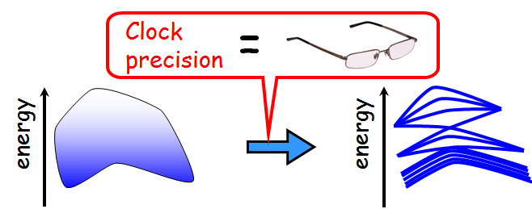

Why alkaline-earth (like) atoms?
Strongly correlated materials
Spin-orbit coupling
Charge
orbital
Many-Body Physics
³P₀,¹S₀
Spin
^{Nuclear spins}

Slide 15





Basic Scattering in quantum mechanics
𝜓(r)$∝$ $e^{ikz}+f(θ)\frac{e^{ikr}}{r}$
Goal: find scattered wave
f: scattering amplitude
Solve Schrödinger
$−\frac{ℏ^{2}}{2M}∇_{R}^{2}ψ−\frac{ℏ^{2}}{2μ}∇_{r}^{2}ψ+V(r)ψ$=E$ψ$
$ψ\left(R,r\right)=$ $Ψ_{CM}^{ }(R)Ψ_{ }^{ }(r)$
cross section
r=r₁-r₂ relative coordinate, μ=$m$/2: reduced mass
R=(r₁+r₂)/2 Center of Mass coordinate, $M=2m,$ Total mass

Slide 16







Partial Wave Expansion
Angular momentum is quantized:
l = 0, 1, 2… s-, p-, waves, …
$VT\left(r\right)=V(r)$ $+\frac{ℏ^{2}ℓ(ℓ+1)}{2μr^{2}}$
Ψ(r) =$\sum_{ℓ,m}^{ }{R_{ℓ,m}{\left(r,E\right)Y}_{ℓ,m}{(θ, φ)}}$
$$\frac{ℏ^{2}k^{2}}{2μ}=E$$
Centrifugal barrier
$\frac{ℏ^{2}}{2μ}\left(\frac{1}{r^{2}}\left(r^{2}\frac{d}{dr}\right)+k^{2}−\frac{ℓ(ℓ+1)}{r^{2}}\right)R_{ℓ,m}$= $V(r)R_{ℓ,m}$
l=1
l=0
r
$$VT\left(r\right)(a.u)$$
Van der Waals
-C₆/r⁶
$$R_{ℓ,m}(r→∞)→\frac{C_{ℓ,m}}{kr}\sin\left[kr−ℓ\frac{π}{2}−δ_{ℓ}\right]$$
There is only a phase shift at long range!!
Chemical bonding
Solve Schrödinger equation for each l to get $δ_{ℓ}$, $C_{ℓ,m}$
$$f\left(θ\right)=\sum_{ℓ}^{ }{{(2ℓ+1)P}_{ℓ}({\cos{θ})}}f_{ℓ}{ }$$
$$f_{ℓ}=\frac{(e^{2iδ_{ℓ}}−1)}{2ik}$$

Slide 17








Low Energy Collisions
(1) At ultra-cold temperatures $k→0$
l =0 collisions dominate!!
$$\frac{δ_{ℓ}}{k}→−A_{ℓ}{(A_{ℓ}k) }^{2ℓ}$$
$$A_{0}=a_{ }$$
“scattering length”
Characterize s-wave collisions
$$A_{1}=b^{3}$$
“scattering volume ”
Characterize p-wave collisions
(2) Quantum statistics matter:
Pauli Exclusion principle
Identical bosons: even
Identical fermions: odd
p-wave , l=1
Spatially anti-symmetric
I like Fermions
~30 μK
But Identical fermions
No low energy (l =0)collisions:
s-wave , l=0,
Spatially symmetric
Only (l =1, p-wave): cost energy
r(a₀)
Jun Ye

Slide 18

Pseudo-Potential

Slide 19

Pseudo-Potential
• Two interaction potentials V and V_{ps} are equivalent if they have the same scattering length
• So: after measuring ${a, b}_{ }$ for the real system, we can model with a very simple potential.
$$L^{3}$$
$$\left\langle k | V_{ps} | k′\right\rangle =\frac{{4πℏ}^{2}}{L^{3}m}\sum_{ℓ}^{ }{{\left(2ℓ+1\right)A_{ℓ}^{2ℓ+1}k^{ℓ}{k′}^{ℓ}P}_{ℓ}( \hat{k}∙{\hat{k}}^{′})}{ }$$
V_{ps}
$$\left\langle k | V_{ps}^{ℓ=0} | k′\right\rangle =\frac{{4πℏ}^{2}}{L^{3}m}a$$
Be careful with regularization to avoid divergencies
For s-wave collisions
$$\left\langle k | V_{ps}^{ℓ=1} | k′\right\rangle =\frac{{12πℏ}^{2}}{L^{3}m}b^{3}(k∙k^{′})$$
Note, it is suppressed at low energies
For p-wave collisions
Huang and Yang, Phys. Rev. 105, 767 (1957)
E. Fermi Ricerca Scientifica, 7: 13–52 (1936) Breit Phys. Rev. 71, 215 (1947),
Blatt and Weisskopf Theoretical Nuclear Physics (Wiley, New York, 1952), pp. 74–75
Idziaszek PRA 79, 062701 (2009)
See notes for details

Slide 20

Alkaline-earth Collisions
collide
I
J=0
Electrons independent of nuclear spin → collisions independent of nuclear spin.
(except via Fermi statistics).
Up to N=2I+1=10
SU(N=2I+1) symmetry:
Nuclear spin independent scattering parameters
No spin changing collisions.
M. Cazalilla and A. M Rey Reports on Progress in Physics 77, 124401 (2014)

Slide 21



SU(N) interaction parameters
$$V_{ab}^{±}{\sim \left(b_{ab}^{±}\right)}^{3}$$
$${\sim a_{eg}^{−}}^{ }$$

Slide 22















Two spin polarized atoms - two modes
$$U_{eg}^{−}$$
n₂
n₁
$$V_{gg}^{+}∝b_{gg}^{3}$$
e
$$V_{ee}^{+}∝b_{ee}^{3}$$
g
$$V_{eg}^{+}∝b_{eg}^{3}$$
$$\left|\left.t^{−}\right\rangle \right.$$
$$\left|\left.t^{+}\right\rangle \right.$$
$$\left|\left.t^{0}\right\rangle \right.$$
$$\left|\left.s\right\rangle \right.$$
Only p-wave interactions relevant. No coupling to singlet
What happens if $Ω_{1}≠$ $Ω_{2}$?
Rey et al PRL (2009), Gibble PRL (2009), Yu et al PRL (2010)

Slide 23






Two atom - two modes
$$U_{eg}^{−}$$
n₂
n₁
$$V_{gg}^{+}∝b_{gg}^{3}$$
e
$$V_{ee}^{+}∝b_{ee}^{3}$$
g
$$V_{eg}^{+}∝b_{eg}^{3}$$
What happens if $Ω_{1}−Ω_{2}=ΔΩ≠0$?
$$\left|\left.t^{−}\right\rangle \right.$$
$$\left|\left.t^{+}\right\rangle \right.$$
$$\left|\left.t^{0}\right\rangle \right.$$
$$\left|\left.s\right\rangle \right.$$
Initially thought to be the mechanism leading to density shifts but was ruled out later
Rey et al PRL (2009), Gibble PRL (2009), Yu et al PRL (2010)

Slide 24




Understanding collisions in the clock
Atoms as a quantum magnet: frozen in energy space
M. Martin et al, Science 341, 632 (2013), Rey et al Annals of Physics 340, 311(2014)
$$\hat{H}≈$$
Delocalized modes: Long range interactions

Slide 25






Many-body Hamiltonian: Spin polarized system
$$α,β=e,g$$
Rey et al Annals of Physics 340, 311(2014)
Fermionic Field operator
$$\left\{{\hat{Ψ_{ }}}_{αm}\left(R\right),{\hat{Ψ}}_{βm^{′}}^{†}(R′) \right\}=δ(R−R^{′})δ_{αβ}δ_{m,m′}$$
$$m=9/2$$
2
$$δ$$

Slide 26






Many-body Hamiltonian
Rey et al Annals of Physics 340, 311(2014)
6
$$v_{ }^{α,β}=$$

Slide 27







1D lattice clock: A large spin simulator
³P₀ (e)
¹S₀ (g)
Interaction Energy~ Hz
Weak interactions simplify physics
…………but frozen motional levels
Thermal
Energy lattice:
E(n_{4x},n_{4y})
NO mode changing collisions
ω_{R} ~500 Hz,
E(n_{2x},n_{2y})
E(n_{1x},n_{1y})
Hamiltonian can be reduced to a Spin model with long range couplings

Slide 28



Many-body Hamiltonian
Rey et al Annals of Physics 340, 311(2014)
6
$$v_{ }^{α,β}=$$
$$\left\langle k | V_{ps}^{ℓ=1} | k\right\rangle ∝\frac{b^{3}}{Volume } \frac{ℏ^{2}k^{2}}{2m}∝\frac{b^{3}}{Area a_{ho}^{Z} }k_{B}T∝\frac{b^{3}}{a_{ho}^{Z} }\frac{ℏ^{ }ω_{R}^{ }}{{{{(a}_{ho}^{R})}^{2}k}_{B}T}k_{B}T$$
Temperature Independent
Long Range!!!

Slide 29

Understanding collisions in the clock
Atoms as a quantum magnet: frozen in energy space
M. Martin et al, Science 341, 632 (2013), Rey et al Annals of Physics 340, 311(2014)
$$\hat{H}≈$$
Delocalized modes: Long range interactions

Slide 30





Understanding collisions in the clock
Atoms as a quantum magnet: frozen in energy space
M. Martin et al, Science 341, 632 (2013), Rey et al Annals of Physics 340, 311(2014)
$$\hat{H}≈$$
Delocalized modes: Long range interactions
Collective spin model
$$\hat{H}≈−δ{\hat{S}}^{z}+{\overline{χ^{ }}(\hat{S}}^{z})^{2}+\overline{C^{ }}N{\hat{S}}^{z}$$
$\overline{χ^{ }}$ and $\overline{C^{ }}$: Mean P-wave Interaction parameters
$${\hat{S}}^{α}=\sum_{j=1}^{N}{{\hat{S}}_{n_{j}}^{α}}$$
$\overline{C^{ }}=({\overline{V^{ }}}_{ee}^{+}$−${\overline{V^{ }}}_{gg}^{+}$)/2
$\overline{χ^{ }}={(\overline{V^{ }}}_{ee}^{+}$−${2{\overline{V^{ }}}_{eg}^{+}}_{ }+{\overline{V^{ }}}_{gg}^{+}$)/2

Slide 31



Mean Field: Phase shift
$−δ{\hat{S}}^{z}+{\overline{χ^{ }}(\hat{S}}^{z})^{2}+\overline{C^{ }}N{\hat{S}}^{z}→$ $−δ{\hat{S}}^{z}+{2χ̅\left\langle {\hat{S}}^{z}\right\rangle \hat{S}}^{z}+\overline{C^{ }}N{\hat{S}}^{z}$
Density Shift
$δ$ $→δ−{2χ̅\left\langle {\hat{S}}^{z}\right\rangle }^{ }+\overline{C^{ }}N$
Spin precesses at a rate that depends on atom number and excitation fraction
Controlled by pulse area $θ$

Slide 32




P-wave interactions: 1D lattice clock
M. Martin et al, Science 341, 632 (2013), Rey et al Annals of Physics 340, 311(2014)
Theory vs experiment
4
$$\left\langle {\hat{S }}^{−}(τ)\right\rangle =\left|\left\langle {\hat{S }}^{−}(τ)\right\rangle \right|{e^{−i(δ+∆δ)τ}}$$
θ controlled by first pulse
2
Contrast
Phase
0
$${∆δ}^{ }{\sim N}_{ }\left(\overline{C^{ }}−\overline{χ^{ }}\cos{θ_{ }} \right)$$
-2
-4
Determine p-wave interaction parameters
4
-6
Operate sweet spot: no density shift
6
-8
0.1
0.2
0.3
0.4
0.5
0.6
0.7
0.8
Excitation fraction: (1-$\cos{θ_{ })/2}$
In Yb:
Ludlow et al, Phys. Rev. A 84, 052724 (2011)
Lemke et al PRL 107, 103902 (2011)

Slide 33


Quantum correlations – beyond mean field
M. Martin et al, Science 341, 632 (2013), Rey et al Annals of Physics 340, 311(2014)
$$\left\langle {\hat{S }}^{−}(τ)\right\rangle =\left|\left\langle {\hat{S }}^{−}(τ)\right\rangle \right|{e^{−i(δ+∆δ)τ}}$$
Contrast
Phase
At the mean field level interaction only affect the precession rate.
But….. in the experiments there are many pancakes with different atom number.
Mean-field interactions causes the pancakes with more atoms to precess faster.
Signal adds → contrast decay due to dephasing
1D
Atom number decay also leads to decay of the amplitude

Slide 34



Comparisons with experiment
M. Martin et al, Science 341, 632 (2013)
Ramsey fringe decay vs. the spin tipping angle
To eliminate the effect of decay we normalize the amplitude with atom number
Symbols: Exp data lines: mean field
Shift
2π/9
π/2
Normalized Amplitude
π/3
2π/3
Excitation fraction
Failure of mean field theory
time (ms)

Slide 35











Quantum correlations – beyond mean field
M. Martin et al, Science 341, 632 (2013), Rey et al Annals of Physics 340, 311(2014)
Contrast: $\sqrt{{〈S^{x}〉}^{2}+{〈S^{y}〉}^{2}}$
Quantum correlations induce faster decay of the amplitude
We can solve for the full many body solution using the Truncated Wigner Approximation:
Average over random initial conditions that account for quantum noise distribution
Coherent Spin states
$$\frac{\left(|\left.↑\right\rangle \text{+ }|\left.↓\right\rangle \right)}{\sqrt{2}}$$
$\left\langle {{\hat{S}}_{xy}}_{ }\right\rangle$=N/2
$\left\langle {{\hat{S}}_{y,z}}_{ }\right\rangle$=0
Normalized Contrast
z
$$\left\langle ∆{{\hat{S}}_{y,z}}_{ }\right\rangle =\sqrt{\frac{N}{4}}$$
x
y
See: Polkovnikov Annals of Physics 325,1790 (2010), J. Schachenmayer et al PRX 5, 011022 (2015)

Slide 37
Why alkaline-earth (like) atoms?
Strongly correlated materials
Spin-orbit coupling
Charge
orbital
Many-Body Physics
³P₀,¹S₀
Spin
^{Nuclear spins}

Slide 38



S-Wave Many body Hamiltonain
$$σ,σ^{′}=e,g$$
Fermionic Field operator
$$\left\{{\hat{ψ_{ }}}_{σm}\left(r\right),{\hat{ψ}}_{σ^{′}m^{′}}^{†}(r′) \right\}=δ(r−r^{′})δ_{σ,σ′}δ_{m,m′}$$
$$m^{′},m$$
Ground-ground
Excited-Excited
Direct
e
Exchange
g
9/2
7/2

Slide 39
P-wave Many body Hamiltonain

Slide 40








Probing Exchange Interactions: Two ¹⁷³ Yb Atoms
G. Cappellini et al PRL 113, 120402 (2014) && F. Scazza et al Nature Physics 10, pages 779 (2014)
Eigenstates of Interaction
$$U_{eg}^{±}∝\frac{{4πℏ}^{2}}{m}a_{eg}^{±}$$
$\left|+\right\rangle =\frac{|\left.eg\right\rangle +|\left.ge\right\rangle }{\sqrt{2}}⊗$ $\frac{|\left.↑↓\right\rangle −|\left.↑↓\right\rangle }{\sqrt{2}}$
$\left|−\right\rangle =\frac{|\left.eg\right\rangle −|\left.ge\right\rangle }{\sqrt{2}}⊗$ $\frac{|\left.↑↓\right\rangle +|\left.↑↓\right\rangle }{\sqrt{2}}$
Lattice site
$$\left|ψ(0)\right\rangle =|\left.e↓,g↑\right\rangle =\frac{|\left.+\right\rangle −|\left.−\right\rangle }{\sqrt{2}}$$
At $Δ_{B}=0$
$$V_{ex}=\frac{U_{eg}^{+}−U_{eg}^{−}}{2}$$
Exchange

Slide 41





Probing Exchange Interactions: Two ¹⁷³ Yb Atoms
G. Cappellini et al PRL 113, 120402 (2014) && F. Scazza et al Nature Physics 10, pages 779 (2014)
Eigenstates of Interaction
$$U_{eg}^{±}∝\frac{{4πℏ}^{2}}{m}a_{eg}^{±}$$
$\left|+\right\rangle =\frac{|\left.eg\right\rangle +|\left.ge\right\rangle }{\sqrt{2}}⊗$ $\frac{|\left.↑↓\right\rangle −|\left.↑↓\right\rangle }{\sqrt{2}}$
$\left|−\right\rangle =\frac{|\left.eg\right\rangle −|\left.ge\right\rangle }{\sqrt{2}}⊗$ $\frac{|\left.↑↓\right\rangle +|\left.↑↓\right\rangle }{\sqrt{2}}$
Lattice site
$$\left|ψ(0)\right\rangle =|\left.e↓,g↑\right\rangle =\frac{|\left.+\right\rangle +|\left.−\right\rangle }{\sqrt{2}}$$
At $Δ_{B}=0$
Depends on magnetic field
Orbital Feshbach Resonance
PRL 115, 135301( 2015)
PRL 115, 265302 (2015)
PRL 115, 265301 (2015)
$$V_{ex}=\frac{U_{eg}^{+}−U_{eg}^{−}}{2}$$
Exchange

Slide 42




SU(N) orbital magnetism in a 1D lattice Sr Clock
Zhang et al Science, 345,1467 (2014)
spin (nuclear), 10 flavors:
orbital
(electronic)
Atoms trapped in array of disk-shaped pancake
Ultra-stable clock laser
Statistical mixture
B-field
Spectators
Clock

Slide 43











Density shifts and SU(N) symmetry
Zhang et al Science, 345,1467 (2014)
SU(N): density shift only depends on the total number of spectators not on its distribution
$${−1}/2$$
$${−3}/2$$
$${−5}/2$$
$${−7}/2$$
$${−9}/2$$
$$7/2$$
$$5/2$$
$$3/2$$
$$1/2$$
$$9/2$$
$$𝓝_{I }$$
Interrogated
$$𝓝_{S }:Spectators$$
$${ {Δν}^{ }= {Δν}^{I}+ Δν}^{S}$$
Interrogated atoms p-wave shift
Spectators generate a density shift
$${Δν}^{I}{\sim 𝓝}_{I }\left(\overline{C^{ }}−\cos{θ} \overline{χ^{ }}\right)$$
$${Δν}^{S}=\overline{Λ}{𝓝_{S}}^{ }$$
Both s and p-wave contributions

Slide 44






Density shifts and SU(N) symmetry
Zhang et al Science, 345,1467 (2014)
t₁
τ
t₂
Normalized to 4000 interrogated atoms
Slope depends only on p-wave
$${ {Δν}^{I}}^{ }$$
$${ Δν}^{S}$$
Independent of distribution or temperature at the 3% level

Slide 45


Determination of scattering parameters
Use: Relation between p and s-wave through Van-der-Waals coefficient
Z. Idziaszek, P. S. Julienne, Phys. Rev. Lett. 104, 113202 (2010).
Channel | S-wave(ao) | P-wave(ao) | Determination
gg | 96.2(1) | 74(2) | [S-wave] Two-photon photo-associative [P-wave] Analytic relation
eg⁺ | 169(8) | -169(23) | [S-wave] Analytic relation [P-wave] Density shift in a polarized sample
eg⁻ | 68(22) | $${−42}_{−22}^{+103}$$ | [S-wave] Density shift in a spin mixture at different temperatures [P-wave] Analytic relation
ee (elastic) | 176(11) | -119(18) | [S-wave] Analytic relation [P-wave] Density shift in a polarized sample
ee (inelastic) | ${\tilde{a}}_{ee}=$46(19) | ${\tilde{b}}_{ee}=$125(15) | Two-body loss measurement

Slide 46



Slide 47

New generation: 3D ultra-cold fermionic optical lattice clock
  All degrees of freedom at the quantum level:
  Quantum degenerate Fermi gas in a 3D lattice
N~ 10⁵ atoms @T/T_{F} ~ 0.1
Pauli Exclusion Principle
→ 1 atom (clock) per site
Now 12s quantum coherence (Record for quantum coherence in 3D lattices).
Hutson et al PRL,123, 23401 (2019)
S. Campbell et al., Science 358, 90 (2017).

Slide 48




Two orbital SU(N) Hubbard model
Lowest band, Short -range interactions, Nearest neighbor hopping
$$ℏω≫kT,J,U_{X}$$
J
W₀(x)
U_{X}
Tunneling
$$H_{0}=−\sum_{<i,j>,α,m}{J_{α}({\hat{c}}_{i,αm}^{†}}{\hat{c}}_{j,αm}+h.c)$$
i-1
i
Intra-orbital direct
$V={(U}_{eg}^{+}$+$U_{eg}^{−})/2$
$V_{ex}={(U}_{eg}^{+}$-$U_{eg}^{−})/2$
Inter-orbital direct
Inter-orbital Exchange

Slide 49

















Onsite Spectrum
Two atoms
$$U_{eg}^{+}$$
($\left|\left.↑↓\right\rangle \right.\text{+}\left|\left.↓↑\right\rangle )\right.⊗\left|\left.s\right\rangle \right.$
Energy
SU(2) singlet
$$U_{gg}^{ }$$
$$\left|\left.↓↓\right\rangle \right.⊗\left|\left.s\right\rangle \right.$$
$${\hat{c}}_{1}^{†}{\hat{c}}_{2}^{†}\left.|0\right\rangle$$
$$U_{eg}^{−}$$
$$⊗\left|\left.t\right\rangle \right.$$
($\left|\left.↑↓\right\rangle \right.\text{−}\left|\left.↓↑\right\rangle )\right.$
Three atoms: up to one e
W state: Fully Symmetric
Energy
$$2U_{eg}^{+}+U_{gg}^{ }$$
($\left|\left.↑↓↓\right\rangle +\left|\left.↓↑↓\right\rangle \right.\right.\text{+}\left|\left.↓↓↑\right\rangle )\right.⊗\left|\left.s\right\rangle \right.$
$${\hat{c}}_{1}^{†}{\hat{c}}_{2}^{†}{\hat{c}}_{3}^{†}\left.|0\right\rangle$$
SU(3) color singlet: like quarks
3$U_{gg}^{ }$
$$\left|\left.↓↓↓\right\rangle \right.⊗\left|\left.s\right\rangle \right.$$
$$\frac{3U_{eg}^{+}}{2}+\frac{U_{eg}^{−}}{2}+U_{gg}^{ }$$
[$\left|\left.↓↑↓\right\rangle −\left|\left.↓↓↑\right\rangle \right.\right.\text{]}$
[$\left|\left.↑↓↓\right\rangle −\left|\left.↓↑↓\right\rangle \right.\right.\text{]}$

Slide 50













Onsite Spectrum: n-atoms
n atoms: up to one e
n-qubit W state
$$\left(n−1\right)U_{eg}^{+}+U_{gg}^{ }\frac{(n−1)(n−2)}{2}$$
($\left|\left.↑↓∙∙↓\right\rangle +\left|\left.↓⋅↑⋅↓\right\rangle \right.\right.\text{+}⋅⋅\left|\left.↓↓⋅⋅↑\right\rangle )\right.⊗\left|\left.s\right\rangle \right.$
$$\left|\left.s\right\rangle =\right.{\hat{c}}_{1}^{†}{\hat{c}}_{2}^{†}{{\hat{c}}_{2}^{†}⋅⋅\hat{c}}_{n}^{†}\left.|0\right\rangle$$
Energy
$$U_{gg}^{ }\frac{(n)(n−1)}{2}$$
$$\left|\left.↓↓∙∙∙↓\right\rangle \right.⊗\left|\left.s\right\rangle \right.$$
SU(n) singlet
[$\left|\left.↓∙⋅↓↑↓\right\rangle −\left|\left.↓∙⋅↓↓↑\right\rangle \right.\right.\text{]}$
[$\left|\left.↓∙⋅↑↓↓\right\rangle −\left|\left.↓∙⋅↓↑↓\right\rangle \right.\right.\text{]}$
n-1
$$⋅$$
$$\left(n−1\right)V−V_{ex}+U_{gg}^{ }\frac{(n−1)(n−2)}{2}$$
$$⋅$$
$$⋅$$
[$\left|\left.↑↓↓∙⋅↓\right\rangle −\left|\left.↓↑↓∙⋅↓\right\rangle \right.\right.\text{]}$

Slide 51

















Measuring the interaction parameters

Slide 52





Experimental Measurements
Use two-body sites to determine scattering lengths
$$U_{X}^{ }=G_{X}^{ }\int{{dr}^{3}|W_{0}\left(r\right)|^{4}}$$
$$G_{X}^{ }=\frac{4π{a_{X}^{ }h}^{2}}{m}$$
Chanel | s-wave(a₀): 1D | s-wave(a₀): 3D
$$a_{eg}^{+}$$ | 169(8) | 165.0(0.6)
$$a_{eg}^{−}$$ | 68(22) | 68.6(0.2)

Slide 53

Experimental Measurements
Emergence of multi-body interactions in few-atom sites of a fermionic lattice clock:
A. Goban et al Nature 563, 369 (2018) and M. Perlin and A.M. Rey NJP, 21, 043039 (2019)

Slide 54




Multi-body Interaction Corrections
Higher bands are virtually populated: Broaden single particle Wannier orbitals due to interactions

Slide 55






Multi-body Interaction Corrections in BEC

Slide 56









Multi-body Interaction Corrections
Higher bands are virtually populated: Broaden single particle Wannier orbitals due to interactions
W₀
This broadening can be understood in terms of perturbation theory
H
H
H
H
A. Goban et al Nature 563, 369 (2018) and M. Perlin and A.M. Rey NJP, 21, 043039 (2019)

Slide 57




Multi-body Interaction Corrections
$${H_{i}^{eff}=\sum_{n=2}^{ }{H_{i}^{eff(n)}}}_{ }$$
n-body Hamiltonian
$N_{i}$ Atoms. One e-atom. $N_{i}$ nuclear spins
$$H_{i}^{eff(2)}= \sum_{p≠m}^{N_{i}}{\left[\frac{U_{gg}}{2!}{{{\hat{n}}_{igm}\hat{n}}_{igp}+ }_{ } \frac{V_{eg}}{2!}{{\hat{n}}_{iem}\hat{n}}_{igp}+\frac{V_{eg}^{ex}}{2!}{\hat{c}}_{igm}^{†}{{\hat{c}}_{iep}^{†}\hat{c}}_{igp}{\hat{c}}_{iem}\right]}$$
Michael Perlin
$${H_{i}^{eff(3)}= \sum_{m≠p≠k}^{N_{i}}{\left[\frac{U_{ggg}}{3!}{{{\hat{n}}_{igm}\hat{n}}_{igp}{\hat{n}}_{igk}+ }_{ }\frac{V_{egg}}{3!}{{\hat{n}}_{iem}\hat{n}}_{igp}{\hat{n}}_{igk}+\frac{V_{egg}^{ex}}{3!}{\hat{c}}_{igm}^{†}{{\hat{c}}_{iep}^{†}\hat{c}}_{igp}{\hat{c}}_{iem}{\hat{n}}_{igk}\right]}}_{ }$$
$${H_{i}^{eff(4)}= \sum_{m≠p≠k≠l}^{N_{i}}{\left[\frac{U_{gggg}}{4!}{{{\hat{n}}_{igm}\hat{n}}_{igp}{\hat{n}}_{igk}{\hat{n}}_{igl}+ }_{ }\frac{V_{eggg}}{4!}{{\hat{n}}_{iem}\hat{n}}_{igp}{\hat{n}}_{igk}{\hat{n}}_{igl}+\frac{V_{eggg}^{ex}}{4!}{\hat{c}}_{igm}^{†}{{\hat{c}}_{iep}^{†}\hat{c}}_{igp}{\hat{c}}_{iem}{\hat{n}}_{igk}{\hat{n}}_{igl}\right]}}_{ }$$
$a_{X}$ :Determined from experimental measurements of two particle shifts
No other fitting parameters. All interaction terms computed from perturbative analysis

Slide 58

Multi-body Interaction Corrections
Emergence of multi-body interactions in few-atom sites of a fermionic lattice clock:
A. Goban et al Nature 563, 369 (2018) and M. Perlin and A.M. Rey NJP, 21, 043039 (2019)
Important for the simulation of SU(N) magnetism with alkaline earth atoms

Slide 59



Amazing Physics Waiting to Be Explored
Quantum Magnetism and beyond: Chiral Spin Liquids, Valence Bond solids,..
Heavy fermion physics and beyond
Transition-metal oxides physics and beyond
SU(N) Heisenberg Models
SU(N) Kondo Lattice Models
SU(N) Kugel- Khomskii Models
³P₀ (e)
¹S₀ (g)
A. V. Gorshkov et al., Nature Phys. 6, 289 (2010) Hermele et al PRL 103, 135301 (2009).
Hermele & Gurarie PRB 84, 174441 (2011)
Foss Feig, e al PRA(R) 81, 051603 (2010).
G. Szirmai et al. PRA 84, 011611 (2011)
P. Sinkovicz et al PRA 88, 043619 (2013)
D. Banerjee et al PRL 100, 125303 (2013)
S. Barbarino et al Nat. Com. 6, 8134 (2015)
… many others

Slide 60

Kondo Lattice Model
Describes the physics of a band of conduction electrons (c-electrons) interacting via Heisenberg exchange interaction with localized magnetic moments (f-electrons)
c
f

Slide 61

Rich Phase diagram
A very complex phase diagram, many aspects of which remain unknown
Quantum criticality and non-Fermi liquid behavior
Exotic Superconductivity
At low-temperature the heavy fermions exhibit a specific heat whose linear term is up to 1000 times larger than the value expected from the free-electron theory
Magnetic order
Heavy Fermi liquid
SC
Gegenwart et al, Nature Phys. 4, 186197 (2008).

Slide 62

Implementing the SU(N) Kondo Lattice Model
Deep ³P₀ lattices with one atom per site: (role f electrons)
Shallow ¹S₀ lattice : (role of c electrons)
N can be controlled by initial preparation
V_{ex} can be tunned by displacing the lattices
V_{ex}= (U_{eg}⁻ - U_{eg}⁺ )/2
Foss Feig , Hermele, Rey, PRA (Rapid) 81, 051603 (2010)

Slide 63





SU(N) symmetry: Remarkable consequences in a quantum system
Fundamental: Quarks: SU(3) symmetry, and lattice gauge theories
Easier calculations: 1/N expansion
Error-free quantum computer
New states of matter
D. Banerjee et al PRL 100, 125303 (2013)
See Thomas Gasenzer work
Hermele & Gurarie PRB 84, 174441 (2011)

Slide 64
Why alkaline-earth (like) atoms?
Strongly correlated materials
Spin-orbit coupling
Charge
orbital
Many-Body Physics
³P₀,¹S₀
Spin
^{Nuclear spins}

Slide 65
1D lattice clock: spin-orbit physics
Bromley et al Nature Physics, 14, 399 (2018)
Wall et al PRL,116, 035301 (2016)
Kolkowitz et al Nature, 542,66 (2017)

Slide 66
Spin-orbit coupling: Fundamental in Nature
Coupling between electron motion and its spin: relativistic effect
Spintronic devises
Topological superconductors
Quantum Information
Topological Insulators

Slide 67


Ultra-cold Atoms Implementation
SOC generated by laser beams
Advantage: Fully Controllable
Issues: Heating from Raman transitions
Important Steps (before 2016):
Rb: JQI(Spielman), China(J. Pan), Washington St (Engels), Munich(Bloch), Purdue (Engels),Harvard (Greiner): two particles
K: China (Zhang)
Li: MIT (Zwierlein)
Dy: Stanford (Lev)
Yb: Lens (Fallani)
No interplay observed between SOC + interactions in a many-body lattice system
Optical lattice clocks: New opportunities

Slide 68




SOC - Fermions in a 1D lattice Clock
Rabi frequency
Ω e^{ikx}
δ: Laser detuning
a
For Sr: ka=φ=7π /6
³P₀ (e)
ν₀=5x10¹⁴ Hz
φ
¹S₀ (g)
a
Allow tunneling to feel the phase
Only lowest band, thermal population of radial modes: T~ 1 μ K

Slide 69



$$a=λ_{l}/2$$
Ω e^{ikx}
$$k=2π/λ_{c}$$
For Sr: $ka=Φ=7π /6$
Notes:
and thus the wave vector of the probing clock laser is comparable with the lattice magic wavelength spacing. For example in Sr is 7 Pi/6. That means that the phase experience by the atoms from the laser varies from one lattice site to the next.

Slide 70
Notes:
Therefore if one see the internal states, as a synthetic dimension, even in the simplest case of nuclear spin polarized atoms de electronic e-g degrees of freedom generate a synthetic ladder. Note that in this ladder there is a net phase phase accumulated by the atoms when it hoper around a plaquette

Slide 71
Two-leg flux ladder

Slide 72
















Spin-orbit coupling
³P₀ (e)
$$H_{q}={\vec{B_{ }}}_{SOC} (q)∙{\hat{\vec{σ}}}_{ }$$
${\vec{B_{ }}}_{SOC} \left(q\right)=\frac{1}{2}\{Ω_{ },0,{ΔE}_{ }\left(q\right)−δ$}
¹S₀ (g)
${ΔE}_{ }^{ }\left(q\right)= [E_{e}^{ }−E_{g}^{ }$]/2
$$E_{ }^{ }\left(q\right)$$
$$E_{e}=−2\operatorname{Jcos}\left(qa\right)$$
$$E_{e}=−2J\cos\left(qa+φ\right)$$
$$Ω_{ }$$
$$Ω_{ }$$
−π
$q0a$+φ
0
$$q0a$$
$$qa$$
π
$$δ$$
${ k}_{C}a=π\frac{λ_{lat}}{λ_{C}}=ϕ=7π/6$
$$E_{g}=−2J_{ }\cos\left(qa\right)$$
Notes:
Let’s now examine the effect of the phase in Rabi specroscopy. Also note that in the presence of tunneling is better to use a Bloch wave basis, in fact the quasi—momentum is a good quantum number. The simples way to see the effect of the phase is actually to do a Gauge transformation that shifts the dispersion relation of the e state by an angle phi. In this new gauge the Rabi couples states with the same quasi-momentum. And this the Hamiltonian can be written as B \dot sigma with B having an x component proportional to the Rabi frequency and a z component that is momentum dependent.

Slide 73












Spin-Orbit Coupling
$$H_{qυ}={\vec{B_{ }}}_{eff} (q)∙{\hat{\vec{σ}}}_{ }$$
${ΔE}_{ }^{ }\left(q\right)=−J_{ }[cos\left(qa+Φ\right)−\cos\left(qa\right)$]
$$E_{ }^{ }\left(q\right)$$
$$\left.|ψ_{q}^{−}\right\rangle =\left({cos\left(\frac{θ_{q}}{2}\right)⁡ \atop sin⁡\left(\frac{{θ_{q}}_{ }}{2}\right)⁡}\right)$$
$$−π$$
$$θ_{q}$$
$$π$$
$${\tan{θ}}_{q}=\frac{Ω_{ }}{{ΔE}_{ }^{ }\left(q\right)−δ}$$
$$|{\left.g\right\rangle }_{ }$$
$$|{\left.e\right\rangle }_{ }$$
$$qa$$
Spin-motion locking: non-zero chirality determined by $Φ$
Notes:
The spin orbit coupling is clear and this form and characterized by a spin momentum locking and a non zero chirality. Note that particles on in g state tend to move on average with opposite momentum than particles in the e state. This is just the same chirality exhited by the edge state in the quantum Hall effect. Here it can be easily characterized by the the momentum dependent Block vector in the z-x plane. This angle depends on q, J and Omega and fully characterize the non-trivial topology. The basic idea is to use the clock sensitivity to characterize the chiral band topology.

Slide 74





Rabi spectroscopy
Information about $ϕ$and J for Ω<J
van Hove singularities:
Density of states diverges
Normalized excitation
δ /$\overline{J}$
$$width 2∆=8\overline{J}⁢{\left.Sin[φ/2\right]}^{ }$$
Wall et al PRL116, 035301 (2016).

Slide 75







Rabi spectroscopy
$$|{\left.e\right\rangle }_{ }$$
Lowest band
$$|{\left.g\right\rangle }_{ }$$
$$|{\left.g\right\rangle }_{ }$$
Ω=200 Hz
with radial excitations Ideal case
Lines: theory Symbols: experiment
Δ=VHS Splitting (Hz)
Axial trapping potential (U_{z}/E_{R})

Slide 76




Rabi spectroscopy
$$|{\left.e\right\rangle }_{ }$$
Spectroscopic control of excited band population
No band relaxation for 500 ms
First Excited band
$$|{\left.g\right\rangle }_{ }$$
with radial exc. Ideal case
Δ=VHS Splitting (Hz)
Lines: theory Symbols: experiment
1st band
Lowest band
Axial trapping potential (U_{z}/E_{R})

Slide 77





Momentum resolved spectroscopy
$$|{\left.g\right\rangle }_{ }$$
$$|{\left.e\right\rangle }_{ }$$
Momentum selection: π pulse g-e Ω=10 Hz
Clear up pulse: Remaining atoms in e
Rabi oscillations under a stronger Rabi pulse Ω =100 Hz at δ

Slide 78


Can we measure chirality, θ_{q}?
Using momentum resolve Rabi oscillations we can extract θ_{q}
Clock sensitivity opens the door for the investigation of SOC
Lines: theory Symbols: experiment
θ_{q}
$${\tan{θ}}_{q}=\frac{Ω_{ }}{{ΔE(q)}_{ }^{ }−δ}$$
Notes:
This plot shows the extracted \theta by varying T from 0 to 3 micro K. the results are almosy unsensitive to T. So in principle we are prediting the clock sensitivity cn open the dooe for the investigation of spin orbit coupled ladders.

Slide 79












Ramsey Spectroscopy
Bromley et al Nature Physics, 14, 399 (2018)
$$θ$$
Evolution
$$\frac{π }{2}$$
Measure transverse magnetization
$$τ$$
$$S^{±,z}=\sum_{i=1}^{N}{S_{i}^{±,z}}$$
$$\left\langle {{\hat{S}}_{ }}^{+}(t)\right\rangle =\frac{N}{2}𝒞e^{i2πνt}$$
$$𝒞:contrast$$
$ν$: frequency
$$𝒞=2\left|\left\langle {{\hat{S}}_{ }}^{+}\left(t\right)\right\rangle \right|/N=2/N\sqrt{{\left\langle {{\hat{S}}_{ }}^{x}(t)\right\rangle }^{2}\text{+}{\left\langle {{\hat{S}}_{ }}^{y}(t)\right\rangle }^{2}}$$
$${\left\langle {{\hat{S}}_{ }}^{z}(0)\right\rangle =cte}^{ }$$
Notes:
The system in consideration is Debbies favorite quantum degenerate of potassium 40 atoms in a 3D dipole trap where we use the lowest two hyperfine states to encode an spin ½ degree of freedom. The experiment starts by preparing a fully polarized and thus non-interacting quantum gas with T/Tf~ 0.1-0.3 and 10^4 atoms , which is when by the application of a collective Rf pulse which rotates all the spin to point along the x direction. The system is let to evolve for some time t after which we probe its magnetic properties, in particular its transverse magnetization. Note that for the pi/2 pulse we apply there is a balance population of the up/down states and this the axial magnetization remains always. Zero. We probe the length of the transverse collective spin, define in terms over collective spin operators which sum over the spin of all toms. which here will be used as an order parameters by a second pi/2 pulse which maps coherence into populations .

Slide 80







Ramsey Spectroscopy: Non- Interacting
Bromley et al Nature Physics, 14, 399 (2018)
$${{\hat{H}}_{0}}_{ }=\sum_{i=1}^{N}{ }B_{SOC} (q_{i}){\hat{s}}_{i}^{z}$$
SOC Dephasing: loss of phase coherence
Decay of fringe contrast
$$𝒞=\left|\left\langle {{\hat{S}}_{ }}^{+}(t)\right\rangle \right|{→0 }_{ }$$
$$\frac{π}{2}$$
$$\frac{π}{2}$$
$$τ$$
Β_{soc}
Β_{soc}
Β_{soc}
Β_{soc}
S=N/2
S=N/2-1
S=1
S=0
H₀ does not conserve S. It introduces dephasing: loss of phase coherence
Notes:
Let me start by describing the dynamics that we observe at zero crossing where the system is non interacting. The dynamics is driven by the slight difference in magnetic moment of the two spin states that generate slightly different trapping potential for the two spin states. This energy difference translated in dephaing since there is a energy difference between the energy experience by the up and down atoms in populating the different harmonic oscillator levels which are the good eignenmodesl. Basically the dynamics can be described by spin model where the atoms are frozen in mode space and the following spin model. The dephasing quickly depolized the gas and destroys the transverse magnetization.

Slide 81





Ramsey with SOC: Non-Interacting
J$τ/(2π)$
Interactions ?
Bessel function

Slide 82







With tunneling J>0
Spin model approximation: Frozen motional levels
$${+\frac{ξ}{L} S∙S}^{ } ^{ }$$
$$+\sum_{i}{{B_{SOC} \left(q_{i}\right)s}_{i}^{z}}$$
$$H=$$
$${\frac{χ}{L} (S}^{z})^{2}+\frac{C}{L}𝓝S^{z}$$
q
P-wave
Exchange
SOC: “Dephasing”
Gap protection
Spin dynamics in mode space: (n_{x},n_{y},q)
$ξ={(V}_{eg}$ −$U_{eg}$)/2
N
# atoms
Mean Field Picture
N=500-3 x10⁴
L~1000
$${\hat{H}}_{MF}=\sum_{i}{ }{{{\vec{\hat{s}}}_{i}^{ }}_{ }^{ }∙{\vec{B}}_{i}^{ef}(t)}_{ }$$
$${\vec{B}}_{i}^{ef}=B_{SOC} \left(q_{i}\right){\hat{e}}_{z}{ +}_{ }\left(\frac{N}{L}C+\frac{2χ}{L}\left\langle {S_{z}}_{ }^{ }\right\rangle \right){\hat{e}}_{z}+\frac{2ξ}{L}\left\langle {\hat{{\vec{S}}_{ }^{ }}(t)}_{ }^{ }\right\rangle$$

Slide 83






Ramsey with SOC and Interactions
Bromley et al Nature Physics, 14, 399 (2018)
$$\frac{Nξ}{JL}\sim 0.5$$
$$\left\langle {S_{z}}_{ }^{ }\right\rangle =−\frac{N}{2}cos{θ_{1}}$$
$$\left\langle {S_{y}}_{ }^{ }\right\rangle =evolves due to interactions$$
Mean field density shift
$$ν=\cos{θ}ξ\left(1−\frac{\tan\left(4 Jτ\right)}{\left(4 Jτ\right)}\right)$$
Two-particles
$$C=|cos\left(4 Jτ\right)|$$

Slide 84

Ramsey with SOC and Interactions
Density shift: Time dependent
Lines: theory Symbols: experiment
Jτ/2π
Excitation fraction: (1-$\cos{θ_{ })/2}$

Slide 85
New generation: 3D ultra-cold fermionic optical lattice clock
  All degrees of freedom at the quantum level:
  Quantum degenerate Fermi
  gas in a 3D lattice
Pauli Exclusion Principle
→ 1 atom (clock) per site
N~ 10⁴ atoms @T/T_{F} ~ 0.1
Deep lattices: One atom per site, no tunneling, no collisions. Higher sensitivity at higher densities
S. Campbell et al., Science 358, 90 (2017).

Slide 86





Challenges with 3D lattice clocks
Deep lattice is an issue:
Hutson et al PRL,123, 23401 (2019)
Tensor and vector stark shifts
Excited atoms life shorter due to light scattering: Now 12 s
Idea: Use shallower lattice and suppress tunneling by Pauli Blockade
But during interrogation the laser imprints a phase that it is different between lattice sites
Ω$e^{ik_{c}a_{ }}$
$$a$$
Spin-orbit coupling (SOC)
Bad: Dephasing
Atoms distinguishable: collisions
j-1
j
j+1
Wall,… Ye, Rey, PRL 116, 035301 (2016)
Kolkowitz,… Rey, Ye, Nature, 542, 66 (2017)
Bromley…Rey, Ye Nature Physics, 14, 399 (2018)
Notes:
It happens that operating in a deep lattice is a big issue due to vector and stark shifts generated by the lattice potential amd more importantly by light scattering processes from the lattice beans which reduce the life time of the xciyted state to at most 10 seconds. The idea then is intead work in a shallow lattice where these effects are enormously mitigated by taking advantage of quantum statistics. The idea is that the clock starts the interrogation processes by prepatring a spin polarzed gas with all atoms oin the clock state . Quantum stattisticd even in a shallow lattice prevents tunneling since two fermionic atoms can not have the same quantum state so both can not be in the same lattce iste. However this ideal condition is broken by the clock laser which imprints a diferential phase between differen lattice sites. The basic idea is that given that we are talking abput a clock transition the wavelength of the clock laser is comparable with the lattice spacing. In the case of the clock for example along the laser propagation direction k a ~ pi. Roughly speaking the clock ratates on differeny direction atoms at adjacent lattice sites generating dephasing, making the atoms distinguishable and again vulnerable to collisions.

Slide 87













Hubbard Model in Optical Clocks
$$H=J\sum{{\hat{c}}_{jσ}^{† }{\hat{c}}_{iσ}^{ }}+\frac{Ω}{2}\sum_{j}{e^{ijφ}\left({\hat{c}}_{j↑}^{† }{\hat{c}}_{j↓}^{ }+h.c.\right)+U\sum_{j}{{\hat{n}}_{j↑}^{† }{\hat{n}}_{j↓}^{ }}}$$
$<i,j>$ $σ$
Tunneling
SOC drive
Interaction
Deep confinement along z
Only hopping in the x-y plane: ${\vec{r}}_{j}=(x_{i},$ $y_{i})$
θ
$${φ=k}_{C}^{⊥}a≈\frac{7π}{6}\sin{θ}$$
$${φ=0}_{ }^{ }$$
$$θ=0$$
$${φ=π}_{ }^{ }$$
$$θ={59}^{°}$$
Notes:
The Hamiltnian that governs the dynamics for in the 3D optical lattice cloks is the Hubbard model a minal model for interacting fermions .he effective spin ½ degrees of freedom will be encoded in the two clock states. It features a kinetic energy term parametrized by the tunneling energy J which is only relevant between nearest neighbor sites an din this case ideantcl for the two clock states. I has an onsite interaction energy U which is the energy penalty to have two atoms with different spin at the same site.
Let me however switch to the 3D lattice case that offer another degree of control than we used to our advantage . The basic idea is that if we use tight confinement along the z direction then atoms can not tunnel along z and the dynamics is restricted to the x-y plane. Now since the magntidude of the Soc is set by the projection of the laser along the tunneling direction, \kperp a, we can tune it by changing the propagation direction of the clock laser. For the magic lattice of Sr is 7pi/6 sin \theta with theta the angle of the laser along the z direction we can make it as small as we want by alingning the laser up to a small angle \theta along the z direction
we can make the phase to reach \pi along one direction by tilting the laser by an angle around 60 degrees.

Slide 88



SOC & Interactions an entanglement resource
SOC & Interactions
Spin Squeezed States
Cluster States
Cat States
P. He et al, J. Ye, A.M. Rey, PRR. 1,033075 (2019)
M. Mamaev, R. Blatt, J. Ye and A.M. Rey, PRL 123, 130402 (2019)
M. Mamaev and A. M. Rey PRL 124, 240401(2020)
A one-way quantum computer

Slide 89




Alkaline earth atoms: A great vista ahead !
Su(N)
Heisenberg:
Chiral spin liquid?
Su(N)
Dynamical gauge fields
Super-exchange
Topological superfluid
Temperature
SU(N) Mott-insulator
SU(N) orbital magnetism
Spin-orbital coupling
Kondo Lattice
P-wave magnetism
P-wave su(N) magnetism
Retarded dipolar interactions
Complexity

