Slide 1
Quantum transport in cold atomic systems
T. Giamarchi
http://dqmp.unige.ch/giamarchi/
TexPoint fonts used in EMF.
Read the TexPoint manual before you delete this box.: AAAAAAA

Slide 2
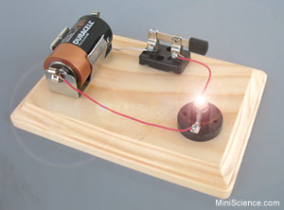
Transport
Condensed matter: a «routine» probe for materials
Theoretically:
complicated !
Out of equilibrium
Typical situation
Often (but not always !) : linear response I=G V

Slide 3


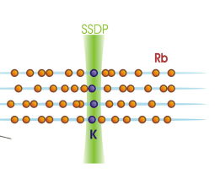
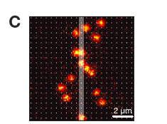
Out of equilibrium situations
Local quench (impurity)
M. Zvonarev, V. Cheianov, TG PRL (2007);
J. Catani et al, PRA 85 023623 (2012) ; T. Fukuhara, A. Kantian et al. Nat Phys. (2013)
A. Kantian, U. Schollwoeck, TG PRL 113 070601 (2015)

Slide 4
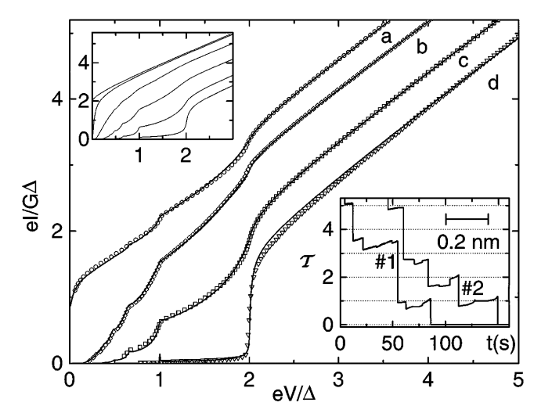
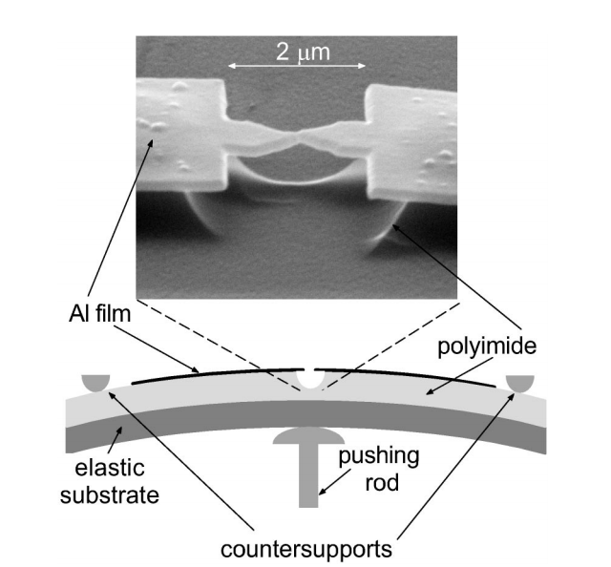
S-S Quantum point contact
Theory: Blonder, Tinkham, Klapwijk (1982); Averin, Bardas (1995); Cueva, Martin-Rodero, Yetati (1996)
E. Scheer et al. PRL 78 3535 (1997)
E. Scheer et al. PRL 78 3535 (1997)

Slide 5
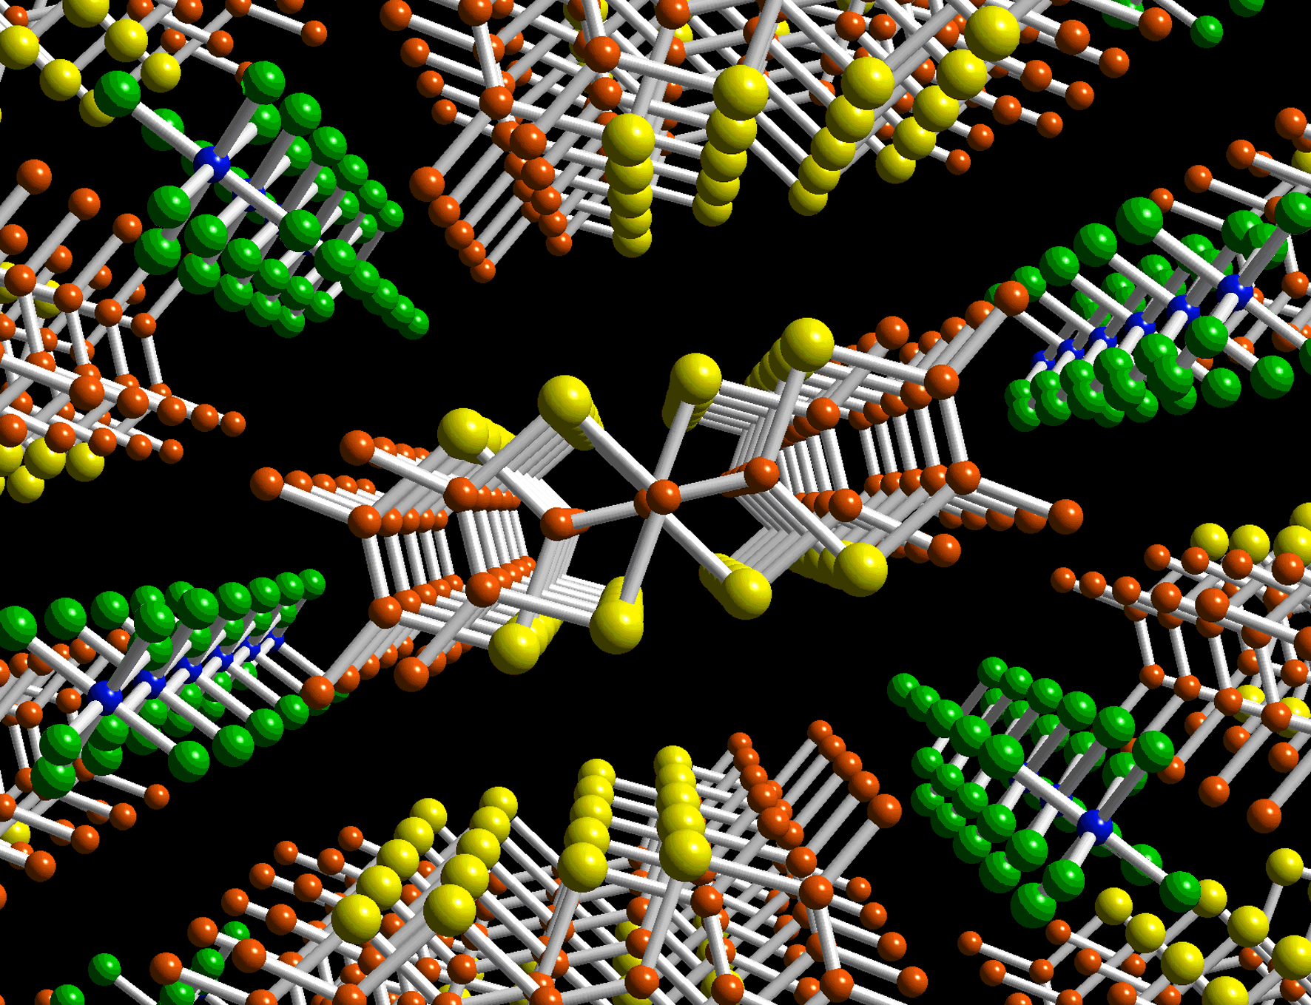
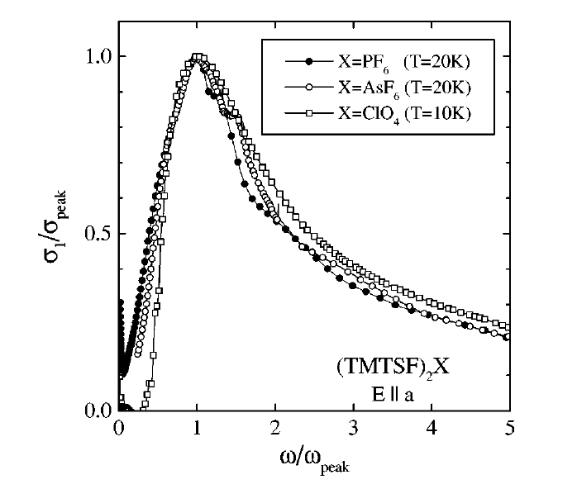
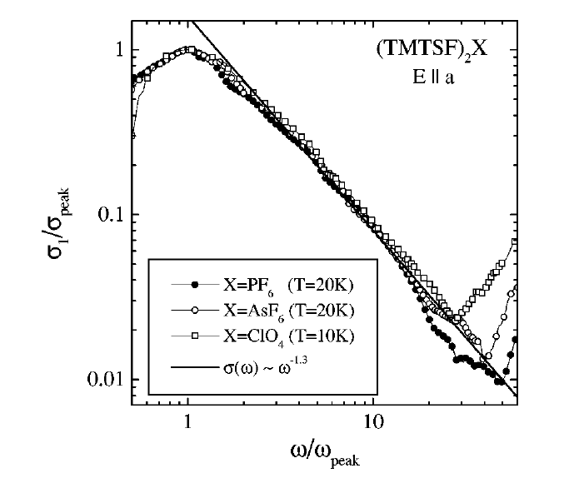
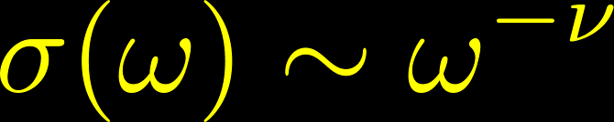
Organic conductors
b
c
TG PRB (91) :
Physica B 230 (1996)
A. Schwartz et al. PRB 58 1261 (1998)
First observation of LL/powerlaw !!

Slide 6
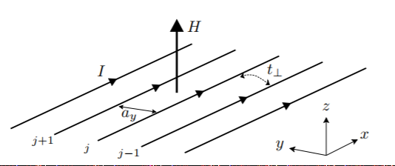
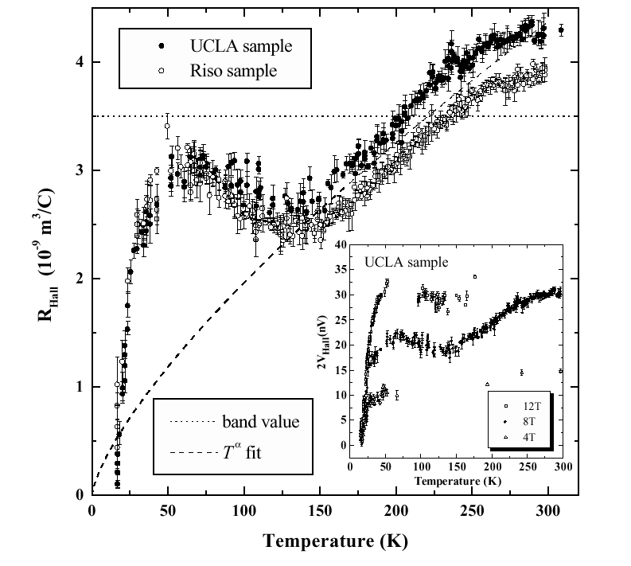
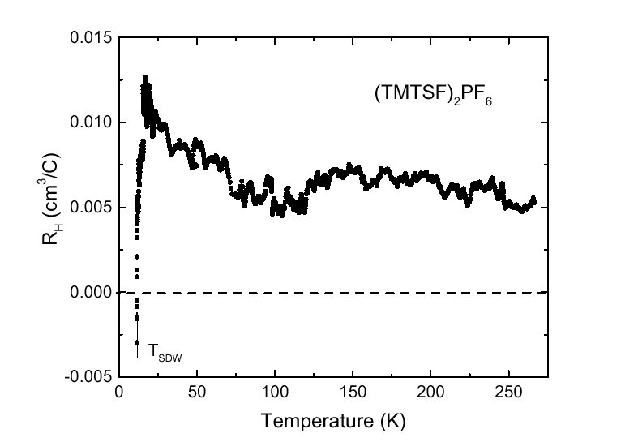
Hall effect condensed matter
J. Moser et al., PRL 84 2674 (00)
G. Mihaly et al., PRL 84 2670 (00)

Slide 7
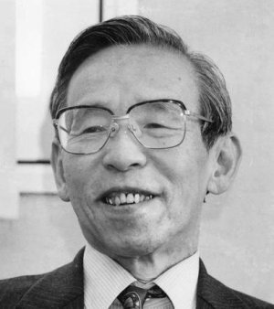
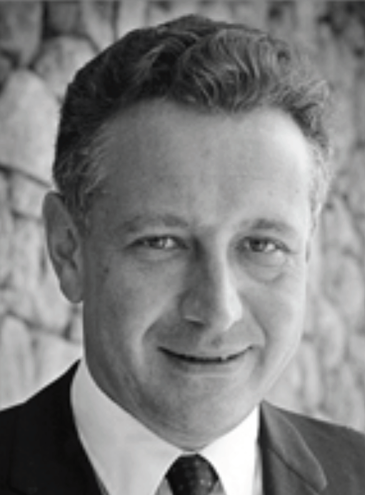
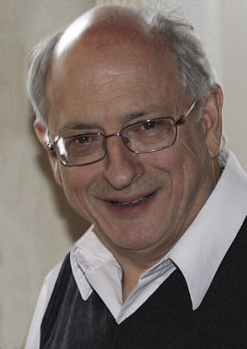
Methods to compute transport
Kubo formula [1957]
https://en.wikipedia.org/wiki/Kubo_formula
Landauer-Büttiker formula [1957]
https://en.wikipedia.org/wiki/Rolf_Landauer
https://de.wikipedia.org/wiki/Markus_Büttiker

Slide 8
Cold atoms

Slide 9


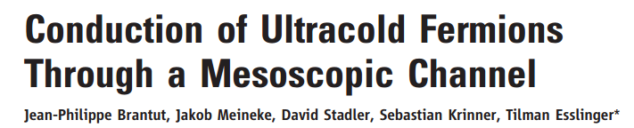

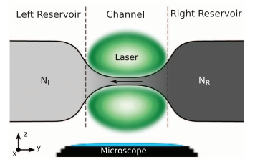
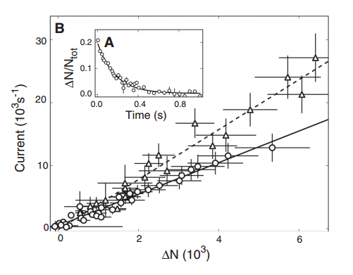
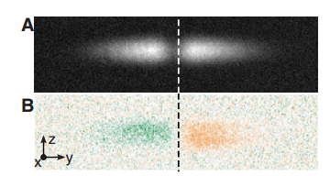
Reservoirs

Slide 10
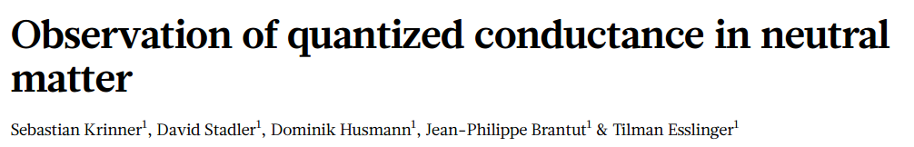
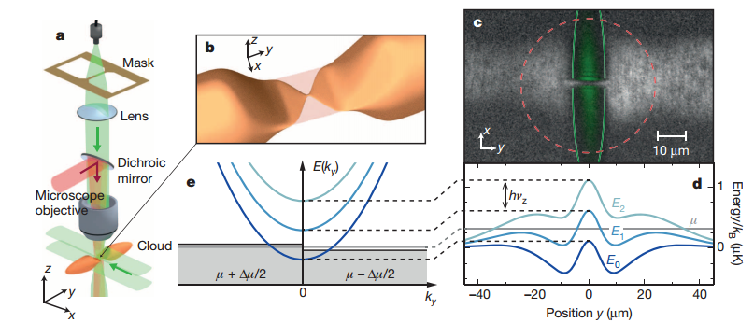
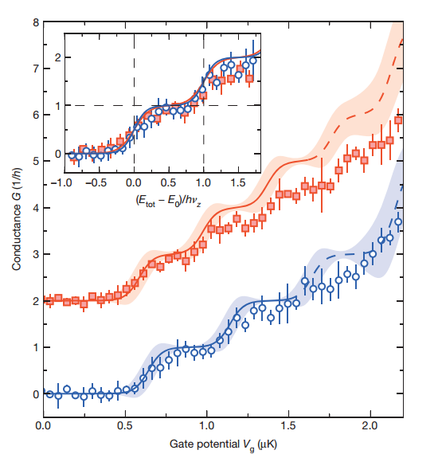

Slide 11
Interaction effects

Slide 12
Bulk/Kubo (shaking, “kick”,..)

Slide 13

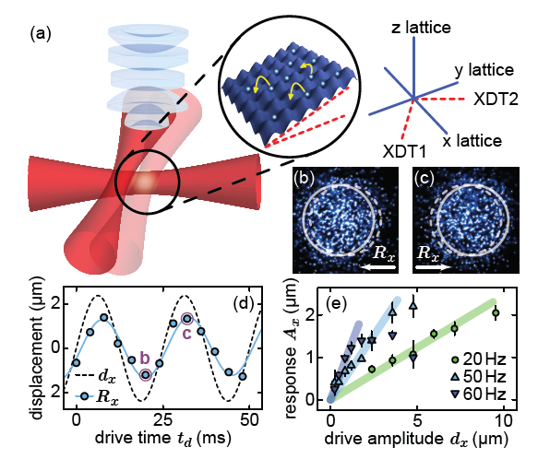
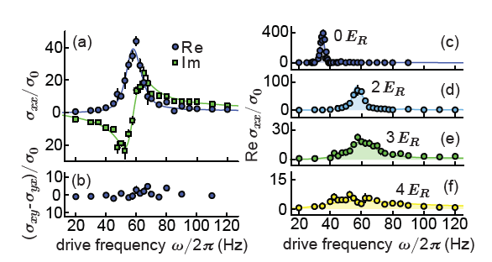
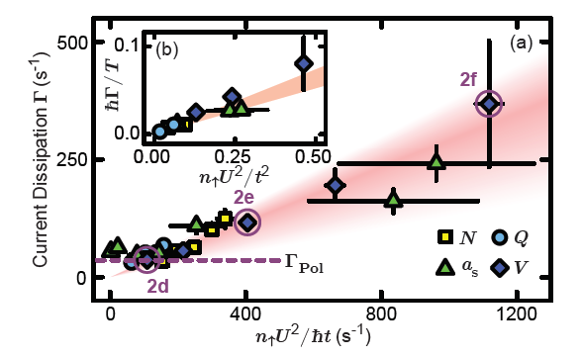
R. Anderson et al. PRL 122 153602 (2017)

Slide 14
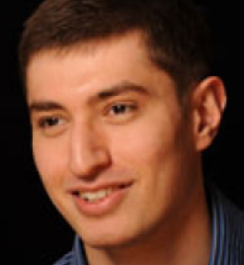
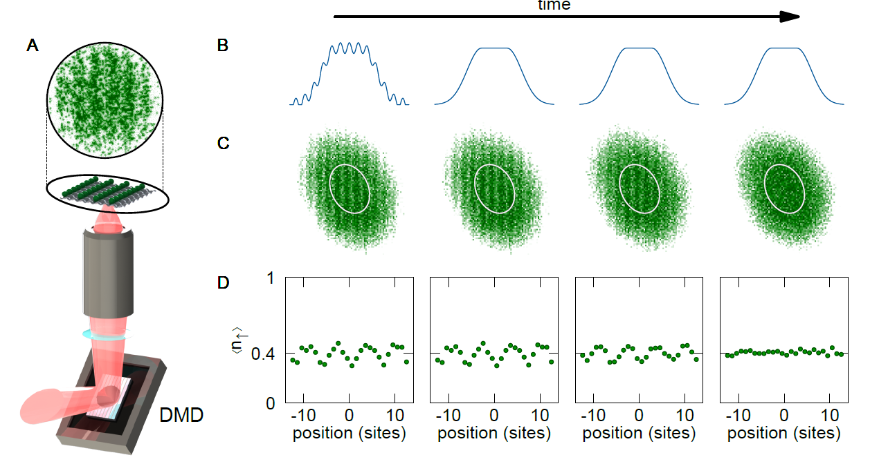
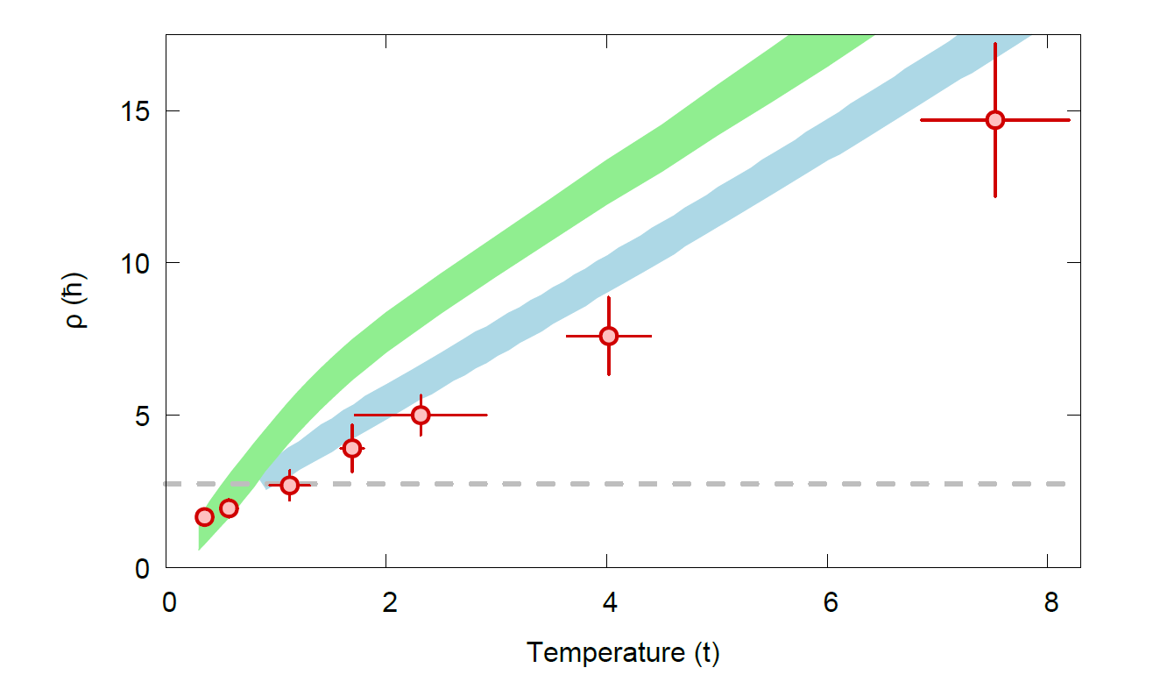
P.T. Brown et al. Science, 363, 379-382 (2019)

Slide 15
Mesoscopic transport

Slide 16


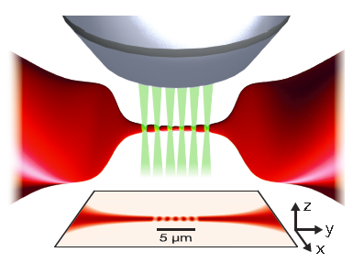
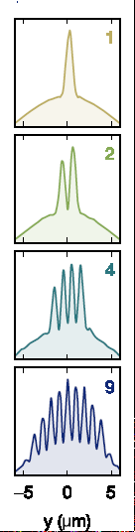
Atomtronic
M. Lebrat, P. Grisins et al., PRX 8 011053 (18)

Slide 17
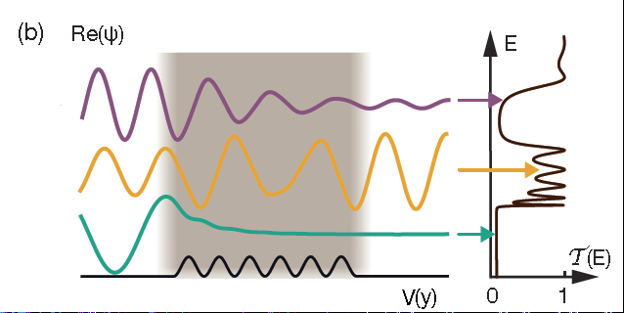

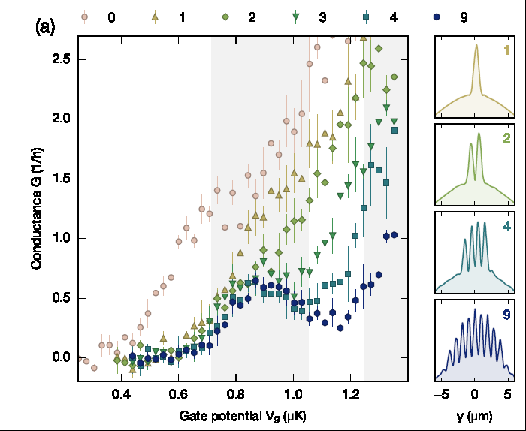
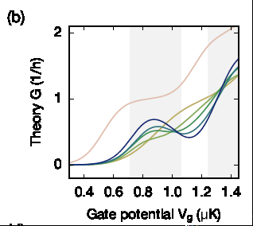
No interactions: band insulator

Slide 18
Weak periodic lattice in 1D
No interactions: band insulator
Attraction: singlet superconductor
Superconductor resists “scattering” (disorder, potentials, etc.)
Expect a competition band insulator-superconductivity

Slide 19
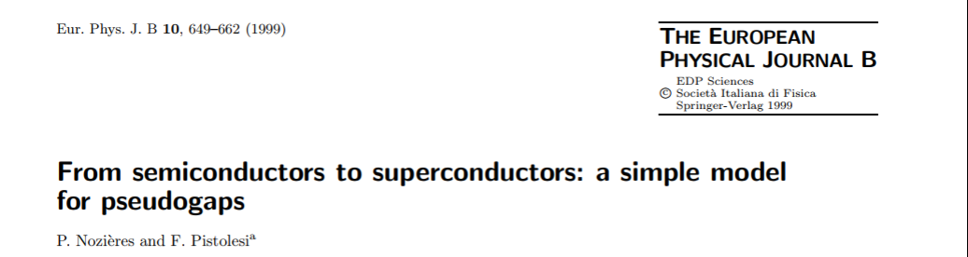
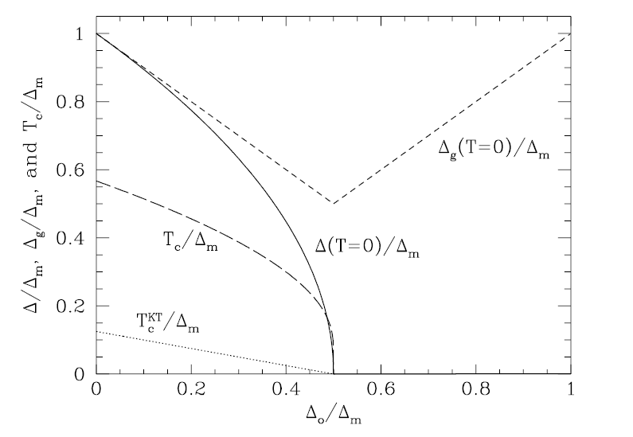
Mean-Field
Superconductor-Band insulator transition
Always true ?
How to test experimentally ?

Slide 20
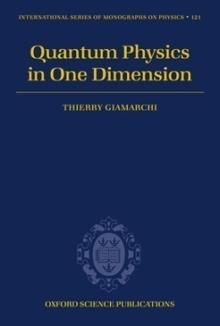
One dimension is special !
Only collective excitations
Spin charge separation !
Spinon
Holon

Slide 21
Mott transition: bosons

Slide 22
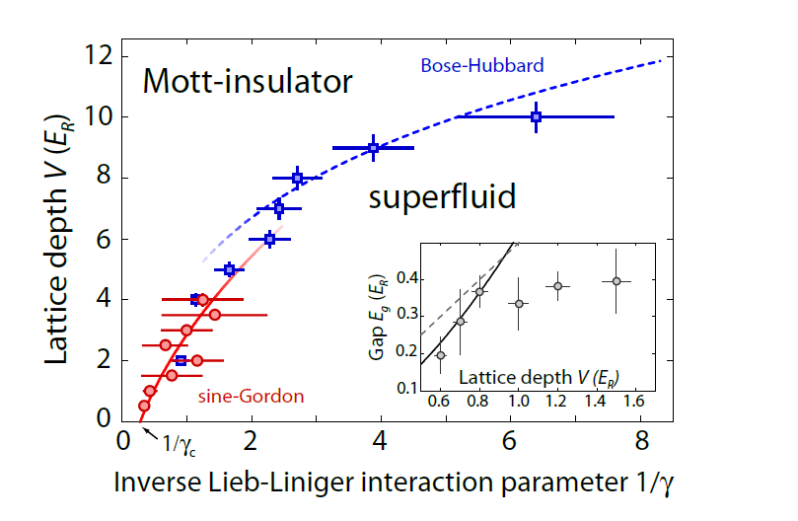

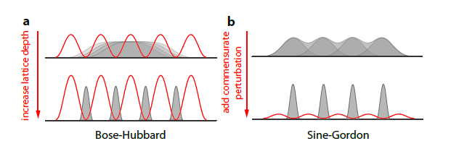
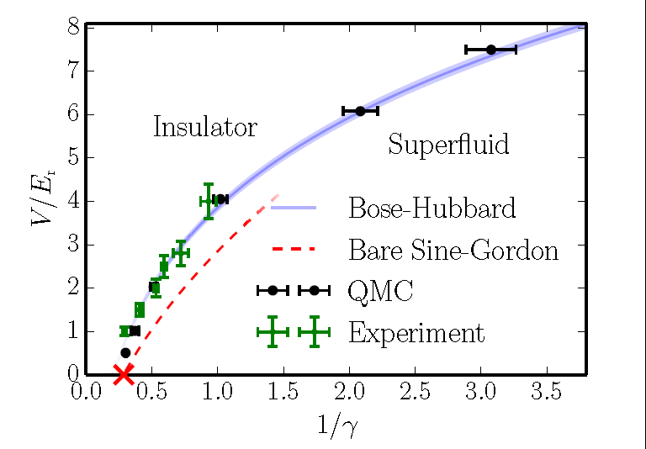


E. Haller et al. Nature 466 597 (2010)
Renormalized Sine-Gordon
Shows:
K* = 2
G. Boeris et al. PRA 93 93, 011601(R) (2016)

Slide 23



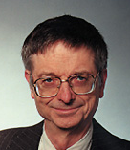
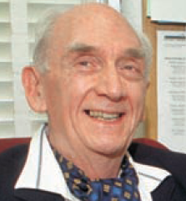
Fermions with attraction
Luther-Emery liquid
Gap in spin sector; Charge Massless (hard core boson/spinless fermions)

Slide 24
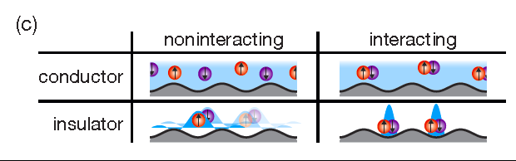
Many-body insulator
``pinned’’ L.E. liquid

Slide 25
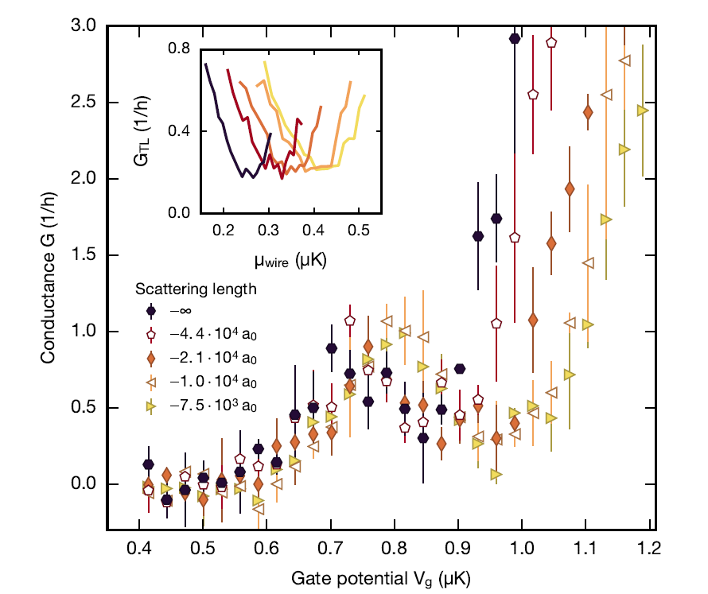
Experimental evidence for L.E. liquid
Notes:
the Gaudin-Yang parameter at the wire center is equal to -1.7;-1.9;-2.3;-2.6 and -3:0

Slide 26
Dissipation

Slide 27
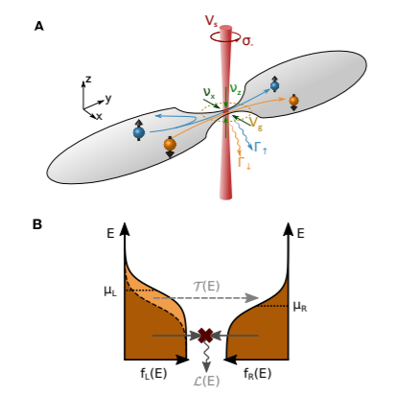
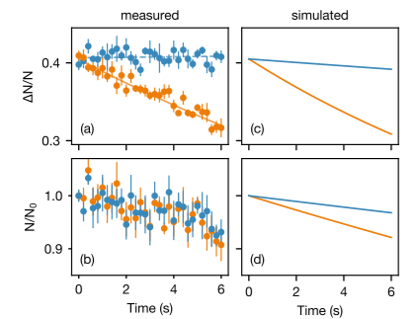
Dissipative Atomic point contact
L. Corman et al. PRA 100 053605 (2019)

Slide 28


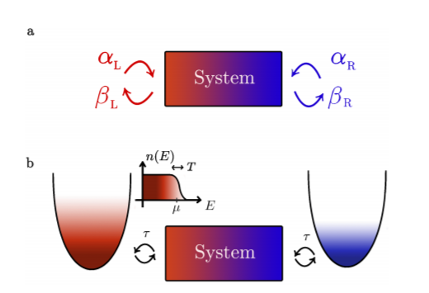
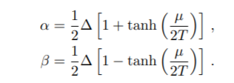
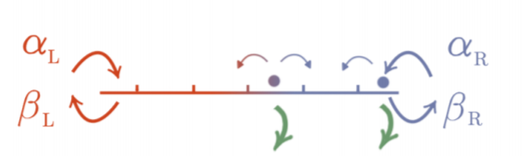
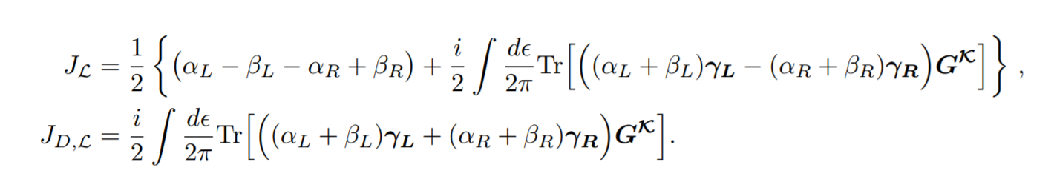

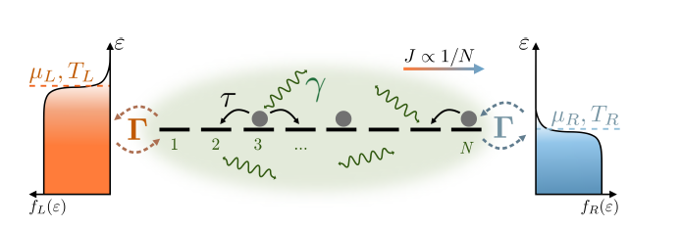
Lindblad reservoirs and losses
T. Jin, M. Filippone, TG PRB 102 205131 (2021)
T. Jin, J. Ferreira, M. Filippone, TG arxiv/2106.14765
Ballistic ?
Diffusive ?

Slide 29
Other transport

Slide 30

Spin transport
A.-M. Visuri, M. Lebrat, S. Häusler, L. Corman and TG, PRR 2, 023062 (2020)

Slide 31




Spin transport and spin drag
Spin Drag:

Slide 32




Solution (using Sine-Gordon)

Slide 33


Comparison with experiments
Notes:
L=5.5 \mu m T=55 nK \rho_0 = 1.6 / \mu m

Slide 34
Non linear transport

Slide 35






Quantum point contact
D. Husmann, S. Uchino, et al. Science 350 62667 (2015).
Quantum point contact: multiple Andreev reflexions

Slide 36



Barrier: Josephson oscillations
G. Valtolina et al. Science 350 6267 (2015)

Slide 37
Artificial Gauge fields

Slide 38

Hall effect
Non interacting ``simple’’
No interactions: curvature of fermi surface
- topological formula (Thouless-Kohmoto)
With interactions: open question

Slide 39



High temperature regime
G. Leon, C. Berthod, TG PRB 75, 195123 (2007)

Slide 40


Cold atoms (balistic !)
D. Genkina et al, NJP 21 053021 (2019)
Notes:
Spielman 87Rb atoms

Slide 41


Hall effect on ladders
S. Greshner, M. Filippone, TG, PRL 122, 083402 (19)
Analytic: calculation on a ring
Experiments: out of equilibrium

Slide 42




Analytic calculations

Slide 43


Numerics

Slide 44



SU(M) symmetric ladders
Notes:
M=2 bosons with U=16tx tx=ty (cross), U=8tx (empty squares), U=tx=ty fermions (plus)

Slide 45




Vanishing Hall response
M. Filippone, C.E. Bardyn, S. Greshner, TG, PRL 123, 086803 (19)

Slide 46

Exact zero of the Hall effect for LB geometry

Slide 47


Topological origin
Central charge

Slide 48

Robustness to perturbations
Temperature: energy gap
Interacting systems:

Slide 49
Beyond small B response

Slide 50


Meissner effect in bosonic ladders
E. Orignac, TG, PRB 64 144515 (2001)

Slide 51

Orbital currents (``Meissner’’ effect)
Field ``Hc1’’: appearance of vortices

Slide 52



Artificial gauge field (cold atoms)
M Atala et al. Nat Phys, 10 588 (2014)

Slide 53





Hall votage vs polarization
M. Buser, S. Greshner, U. Schollwöck, TG, PRL 126, 030501 (21)
Practical protocol to compute Hall voltage Vh from Hall polarization Ph

Slide 54
Many other challenges
Lower temperatures
More homogeneous systems
Disordered systems (Localization)
Transverse transport
Transport through dissipative structures
The sky is the limit !!

Slide 55






Theory:
C. Berthod
S. Uchino
A.-M. Visuri
M. Filippone
M. Buser
T. Jin
G. Leon
P. Grisins
S. Greschner
C. Bardyn
U. Schollwöck
J. Ferreira
Experiments:
Esslinger’s group (ETHZ)
Brantut’s group (EPFL)
Fallani’s group (LENS)

Slide 56


